Slide 1
3. Prediction, Estimation,
Hypothesis Testing

Slide 2



HTTHTTHTTT
Prediction:
Estimation:
Hypothesis
testing:

Slide 3

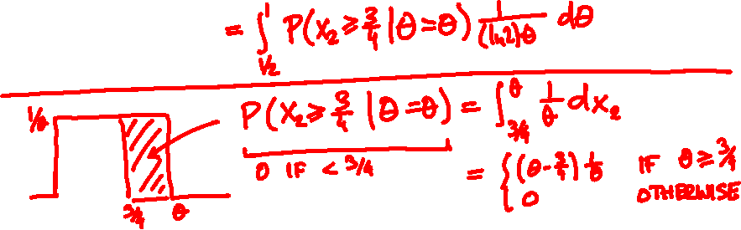
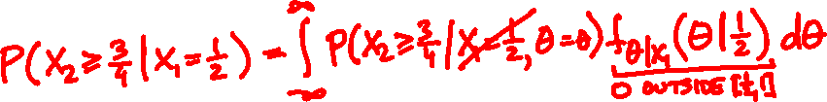
On her first date, Juliet arrives ½ hour late.
How likely to arrive more than ¾ hour late next time?

Slide 4
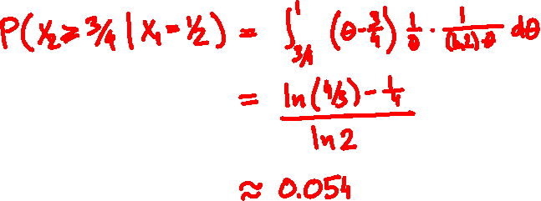

Slide 5
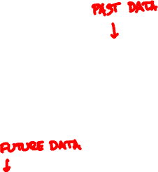
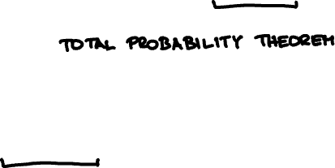
Bayesian prediction
∞
∑
P(E|X = x) = or P(E|Θ) f_{Θ|X}(θ|x) dθ
∫
-∞
∑
P(E| Θ) = or f_{X|Θ}(x|θ) dθ
∫
E
E

Slide 6
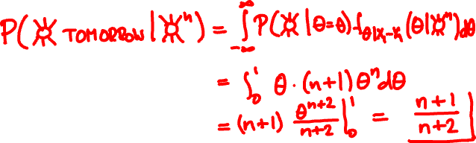
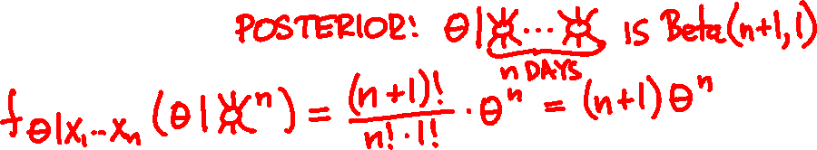
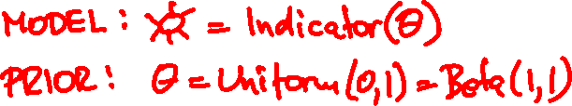
P(☀️ will rise tomorrow) = ?

Slide 7

Point estimation
How to turn conditional PDF/PMF f_{Θ|X}(θ | x) estimate into one number?
Maximum a posteriori (MAP) estimator:
argmax f_{Θ|X}(θ | x)
Conditional expectation (CE) estimator:
Ε[θ | X = x]

Slide 8
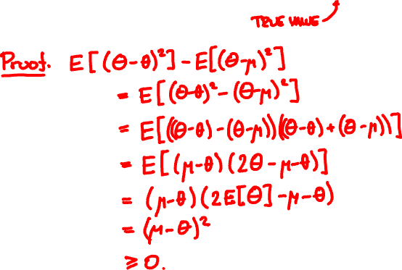
Among all possible θ, the expectation μ = E[Θ]
minimizes the mean squared error E[(Θ – θ)²]

Slide 9
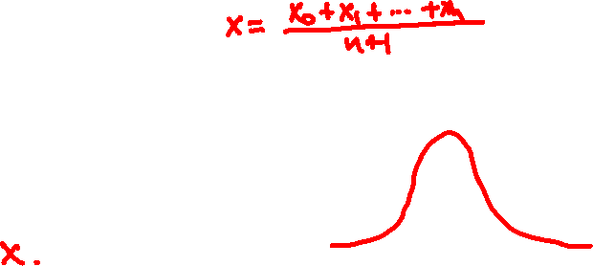


Point estimation for normals
X_{i} = Normal(Θ, 1) independent given Θ
Θ is Normal(x₀, 1)
(Θ | X₁ = x₁, …, X_{n} = x_{n}) is Normal(x, 1/√n)
CE estimate:
MAP estimate:

Slide 10
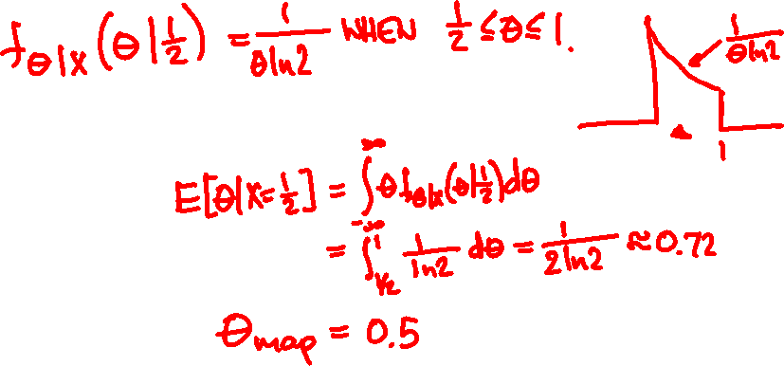

Romeo’s model
X = Uniform(0, Θ)
Θ = Uniform(0, 1)
On her first date, Juliet arrives ½ hour late.
CE estimate:
MAP estimate:

Slide 11
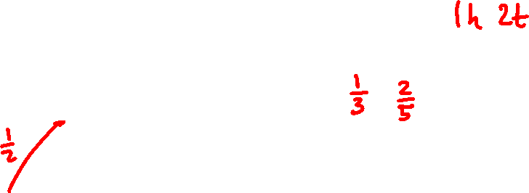
Beta(1, 1)
Beta(2, 3)
CE = α/(α + β)
MAP = h/(h + t)
Beta(11, 21)
Beta(51, 101)

Slide 12
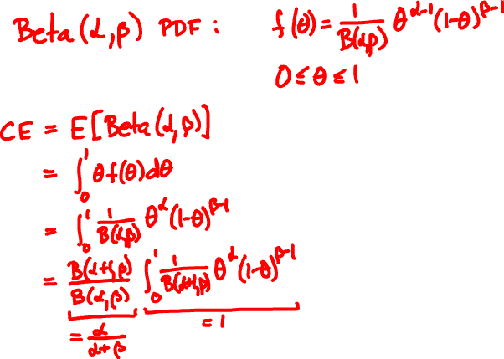
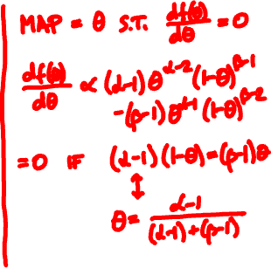
CE and MAP for Beta

Slide 13

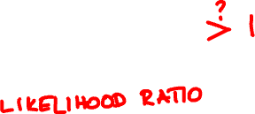

Hypothesis testing
Suppose Θ takes two values (e.g. spam / legit)
MAP = argmax f_{Θ|X}(θ | x)
Choose the one for which f_{Θ|X}(θ | x) is larger

Slide 14
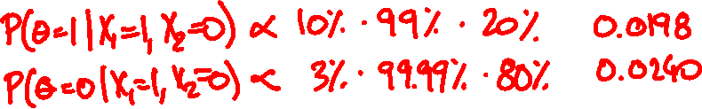

Θ = 80% legit, 20% spam
The Citibank concerning wire transfers of your fund. Your letter has been referred to the (JMCB) Legal Division for Funds (US$2.8 Million Dollars)
θ
P(X₁| θ)
P(X₂| θ)
legit
0.03
0.0001
spam
0.1
0.01

Slide 15

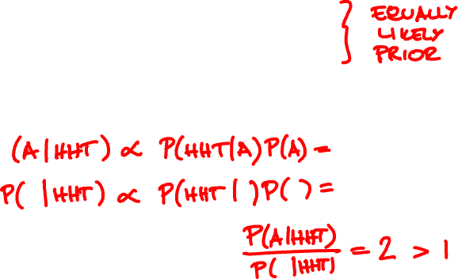
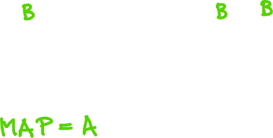
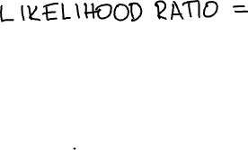

Coin A is heads with probability 2/3.
Coin B is tails with probability 2/3.
HHT are 3 flips of a random coin. Which coin was it?

Slide 16
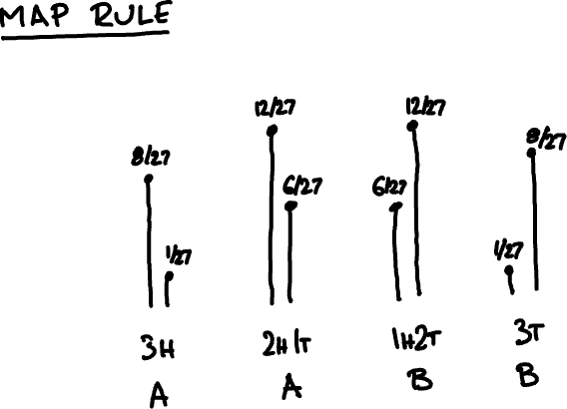
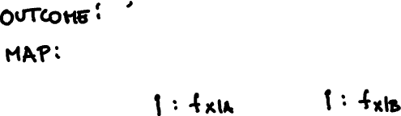

Slide 17

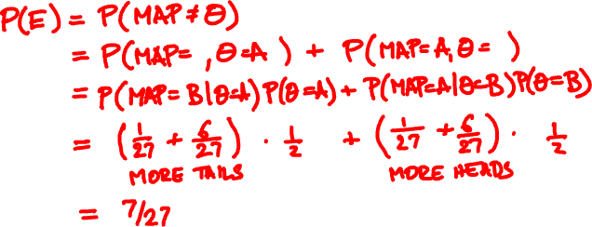

What is the probability you are wrong, given the outcome is HHT?
What is the probability you are wrong on average?

Slide 18
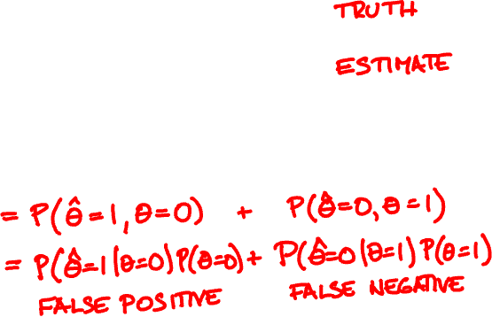
Binary hypothesis testing error
Θ = 0 (null) or 1 (alternative)
^
Θ = 0 (reject) or 1 (accept)
^
error = P(Θ ≠ Θ)

Slide 19

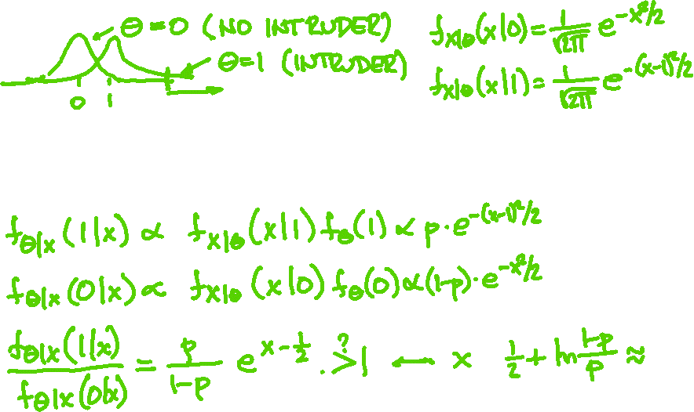


A car-jack detector X outputs Normal(0, 1) if there is no intruder and Normal(1, 1) if there is. When should alarm activate?

Slide 20
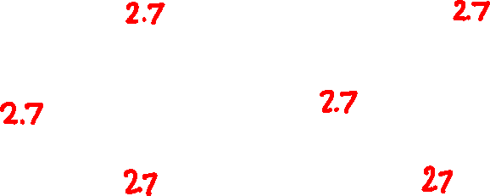
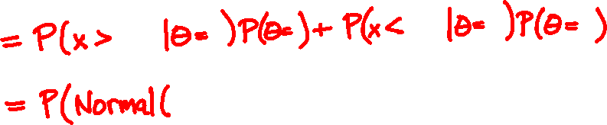
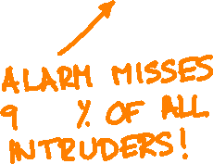




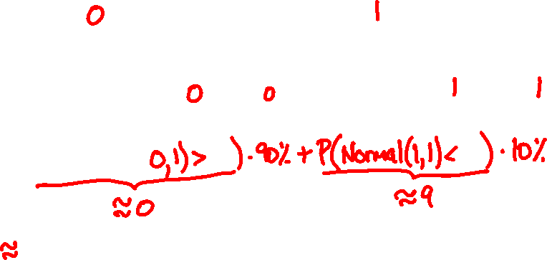
What is the error?

Slide 21
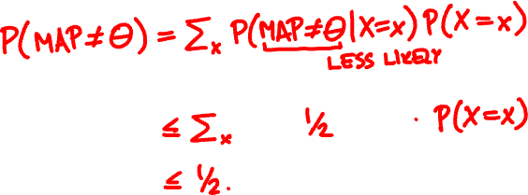
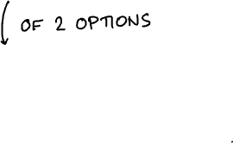
MAP hypothesis testing error
P(MAP ≠ Θ) ≤ 50%
Proof:

Slide 22
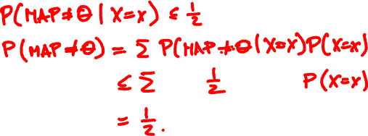
MAP hypothesis testing error
P(MAP ≠ Θ) ≤ 50%
Proof:

