Slide 1
7. Continuous Random Variables
ENGG 2760A / ESTR 2018: Probability for Engineers
Fall 2020

Slide 2



A package is to be delivered between noon and 1pm.
You go out between 12:30 and 12:45.
What is the probability you
missed the delivery?

Slide 3
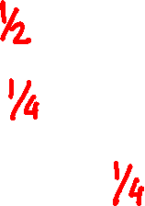
The uniform random variable
P(T ≤ t) = t
assuming 0 ≤ t ≤ 1
P(T > 1/2) =
P(T > 3/4) =
P(1/2 < T ≤ 3/4) =

Slide 4
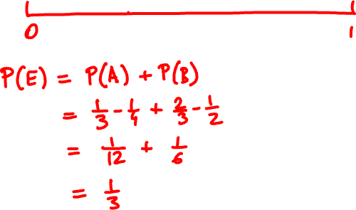
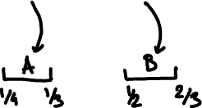
From 12:15 - 12:20 and 12:30 - 12:40 the doorbell wasn’t working.

Slide 5

Continuous random variables
P(T ≤ 0.3) = 0.3
P(T = 0.3) =
P(T < 0.3) =
The probability mass function doesn’t make much sense because P(T = t) = 0 for all t.

Slide 6
Uncountable sample spaces
In Lecture 1 we said:
“The probability of an event is the sum of the
probabilities of its elements”
…but all elements have probability zero!

Slide 7
Cumulative distribution function
The cumulative distribution function of X is
F(x) = P(X ≤ x)
monotone: x ≤ y ⟹ F(x) ≤ F(y)
limits:
lim_{x → -∞} F(x) =
lim_{x → ∞} F(x) =

Slide 8
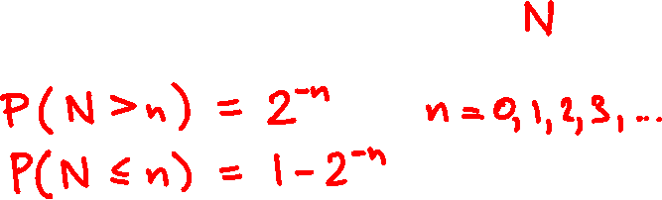
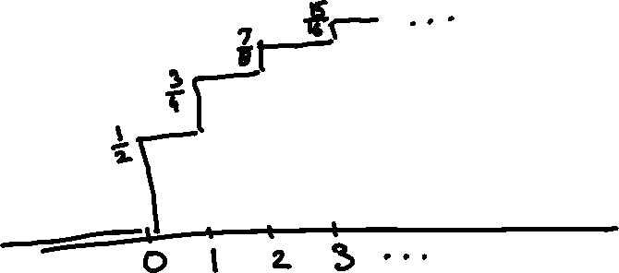
What is the Geometric(1/2) CDF?

Slide 9
Uniform CDF
0
for t < 0
F(t) = P(T ≤ t) =
t
for 0 ≤ t ≤ 1
1
for t > 1

Slide 10
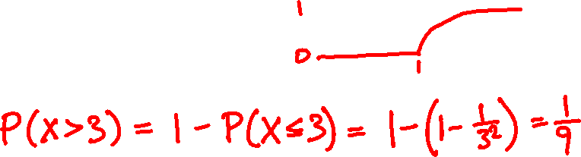
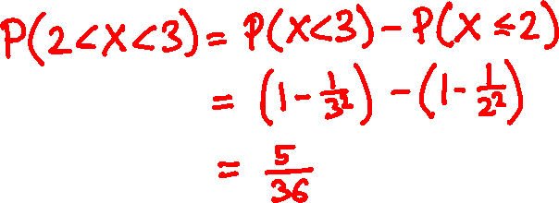
1 – 1/x²
for x > 1
The CDF of X is F(x) =
0
for x ≤ 1
What is P(X > 3)?
What is P(2 < X < 3)?

Slide 11
Cumulative distribution functions
PMF
discrete CDF
?
continuous CDF

Slide 12

Discrete random variables:
PMF f(x) = P(X = x)
CDF F(x) = P(X ≤ x)
f(x) = F(x) – F(x – δ)
F(a) = ∑_{x ≤ a} f(x)
for small δ
Continuous random variables:
The probability density function (PDF) of a random variable with CDF F(x) is
F(x) – F(x – δ)
dF(x)
f(x) =
lim
=
δ
dx
δ → 0

Slide 13
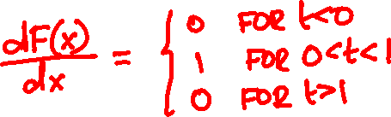
Uniform PDF
0
for t < 0
F(t) = P(T ≤ t) =
t
for 0 ≤ t ≤ 1
1
for t > 1
f(x) =

Slide 14
Probability density function
PMF
discrete CDF
PDF
continuous CDF

Slide 15
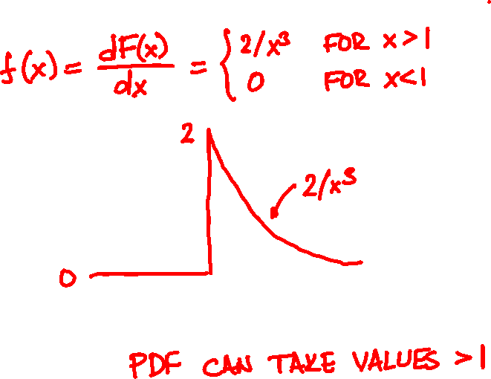
1 – 1/x²
for x > 1
The CDF of X is F(x) =
0
for x ≤ 1
What is the PDF?

Slide 16
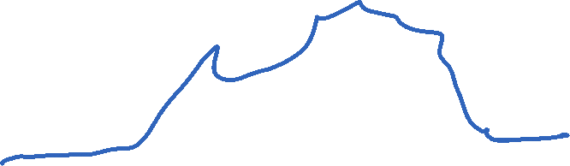
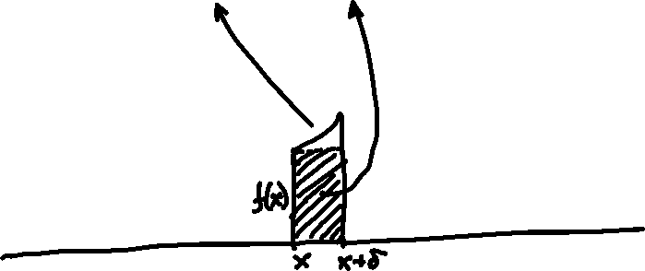
Interpretation of the PDF
The PDF value f(x) δ approximates the probability that X in an interval of length δ around x
P(x – δ ≤ X < x) = f(x) δ + o(δ)
P(x ≤ X < x + δ) = f(x) δ + o(δ)

Slide 17
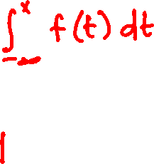
Probabilities from the PDF
P(E) = ∫_{E} f(x)dx
P(X ≤ x) =
∞
∫_{-∞} f(x)dx =

Slide 18
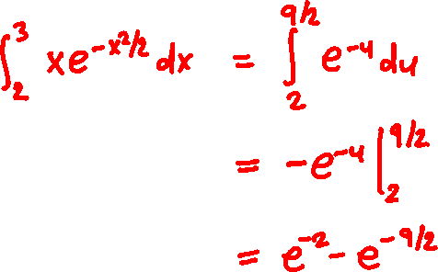
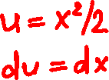
²
x e^{-x /2}
for x > 0
The PDF of X is f(x) =
0
for x ≤ 0
What is P(2 < X < 3)?

Slide 19

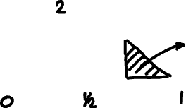
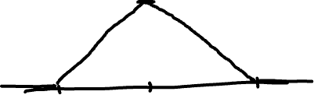
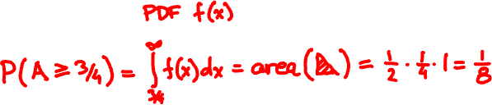
Alice said she’ll show up between 7 and 8,
probably around 7.30.
What is the probability Bob has to wait past 7.45?

Slide 20


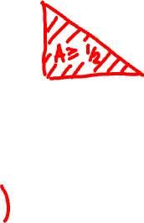

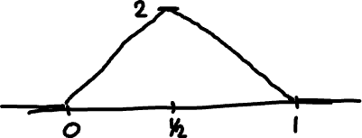
It is now 7.30. What is the probability Bob has to wait past 7.45?

Slide 21
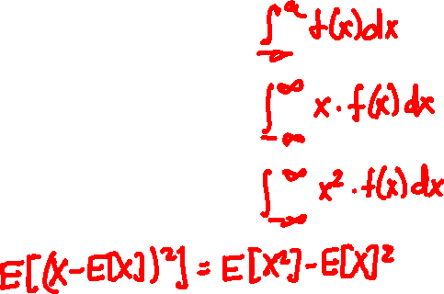
Expectation and variance
PMF f(x)
PDF f(x)
P(X ≤ a)
∑_{x ≤ a} f(x)
E[X]
∑_{x} x f(x)
E[X²]
∑_{x} x² f(x)
Var[X]

Slide 22

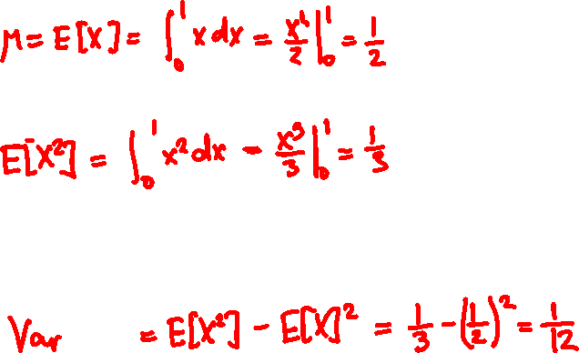
Expectation and Variance of Uniform

Slide 23
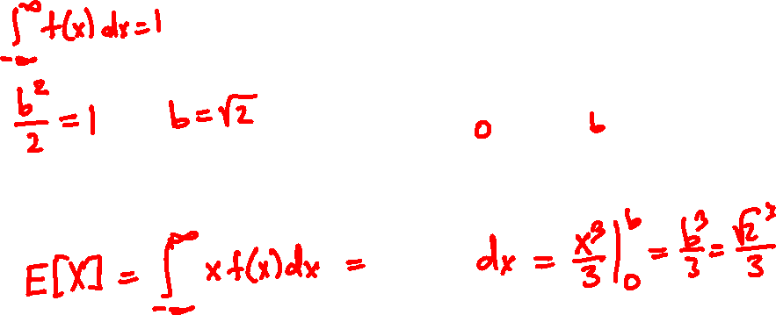
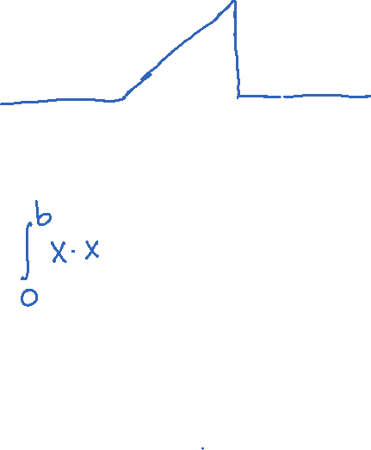
The PDF of X is f(x) = x for 0 < x < b and 0 elsewhere.
What is b?
What is E[X]?

Slide 24


Raindrops
Rain is falling on your head at a rate of λ drops/sec.
1
2
How long do we wait until the next drop?

Slide 25

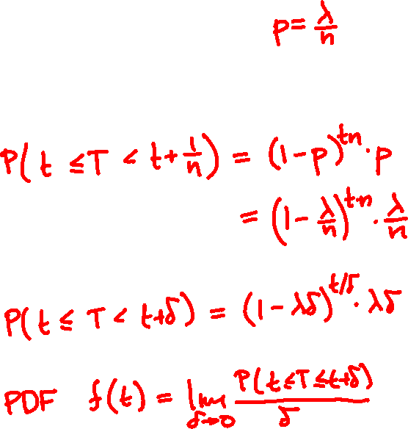


1
2

Slide 26
Geometric(3/10)
Geometric(3/100)
Geometric(3/50)
Exponential(3)

Slide 27

The exponential random variable
The Exponential(λ) PDF is
λ e^{-λt}
if x ≥ 0
f(t) =
0
if x < 0.
λ = 1
λ = 1
PDF f(t)
CDF F(t) = P(T ≤ t)

Slide 28

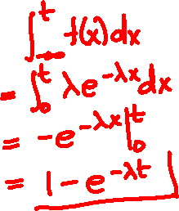
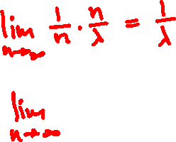

The exponential random variable
CDF of Exponential(λ):
E[Exponential(λ)] =
Var[Exponential(λ)] =

Slide 29
Poisson vs. exponential
N
1
2
T
Poisson(λ)
Exponential(λ)
description
number of events
within time unit
time until first
event happens
expectation
λ
1/λ
std. deviation
λ
1/λ

Slide 30
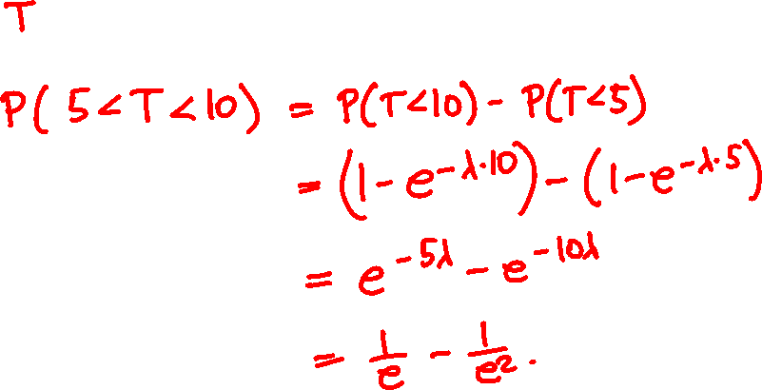
A bus arrives at a rate of one in 5 minutes. How likely are you to wait 5 to 10 minutes?

Slide 31
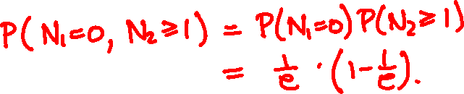
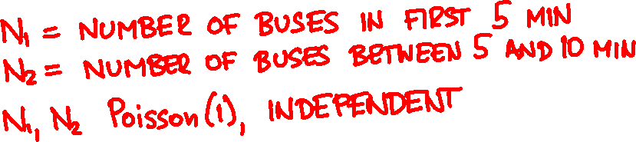

A bus arrives at a rate of one in 5 minutes. How likely are you to wait 5 to 10 minutes?

Slide 32
Binomial(64, 1/2)
Binomial(1000, 1/2)
Binomial(100, 1/2)
Normal

Slide 33

The normal random variable
PDF
CDF
f(x) = (2π)^{-½} e^{-x /2}
F(x) = (2π)^{-½} ∫_{t ≤ x} e^{-t /2} dt
²
²
E[Normal] =
Var[Normal] =

Slide 34


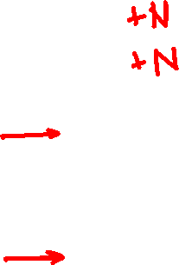
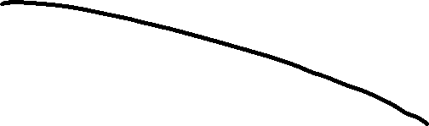
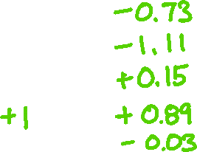
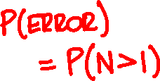

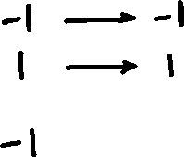

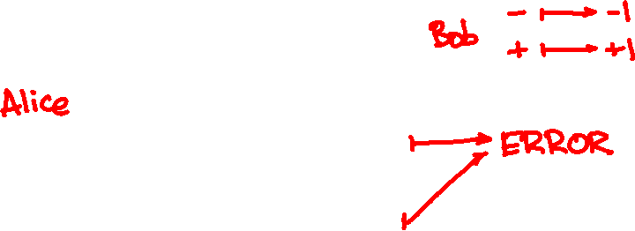
https://homepage.divms.uiowa.edu/~mbognar/applets/normal.html

