Slide 1
6. Conditioning, Independence for Random Variables
ENGG 2760A / ESTR 2018: Probability for Engineers

Slide 2
Conditional PMF
Let X be a random variable and A be an event.
The conditional PMF of X given A is
P(X = x and A)
P(X = x | A) =
P(A)

Slide 3
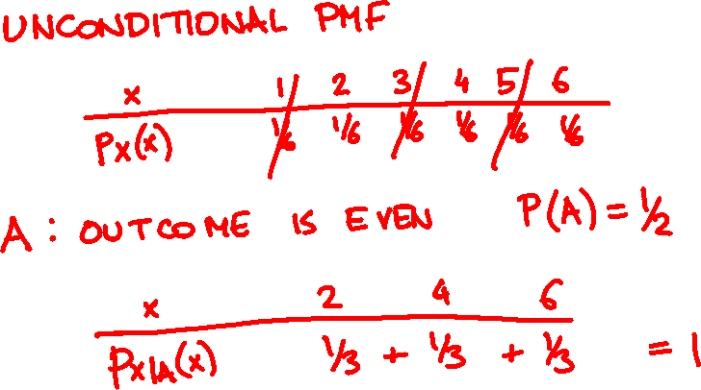
What is the PMF of a 6-sided die roll given that the outcome is even?

Slide 4
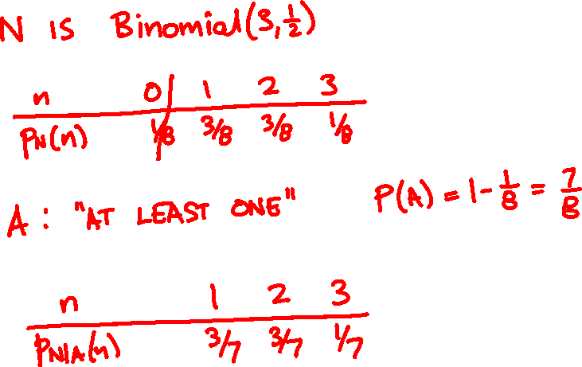
You flip 3 coins. What is the PMF number of heads given that there is at least one?

Slide 5
Conditioning on a random variable
The conditional PMF of X given Y is
P(X = x and Y = y)
P(X = x | Y = y ) =
P(Y = y )
p_{XY}(x, y)
p_{X|Y}(x | y) =
p_{Y}(y)
For fixed y, p_{X|Y} is a PMF as a function of x.

Slide 6
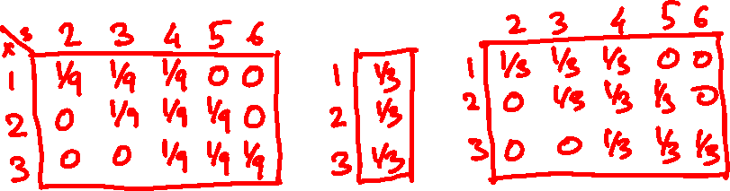

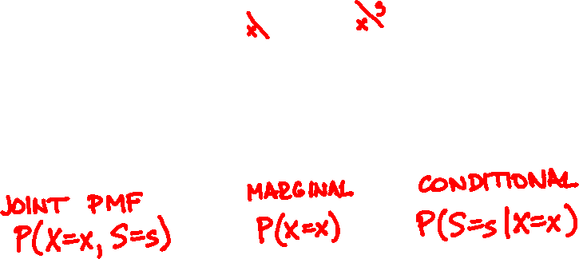
Roll two 3-sided dice. What is the PMF of the sum given the first roll?

Slide 7
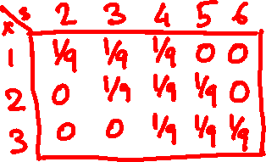
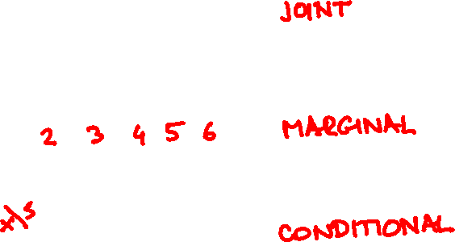
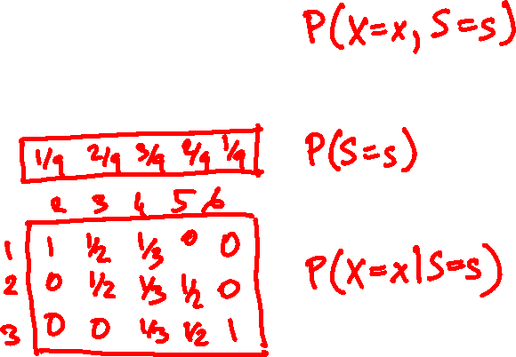
Roll two 3-sided dice. What is the PMF of the first roll given the sum?

Slide 8
Conditional Expectation
The conditional expectation of X given event A is
E[X | A] = ∑_{x} x P(X = x | A)
The conditional expectation of X given Y = y is
E[X | Y = y] = ∑_{x} x P(X = x | Y = y)

Slide 9

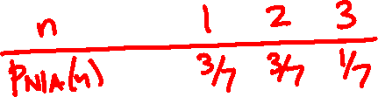
You flip 3 coins. What is the expected number of heads given that there is at least one?

Slide 10
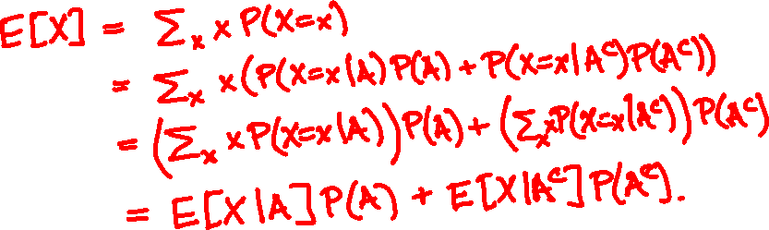
Total Expectation Theorem
E[X] = E[X|A] P(A) + E[X|A^{c}] P(A^{c})
Proof

Slide 11
Total Expectation Theorem (general form)
If A₁,…, A_{n} partition Ω then
A₁
A₃
A₄
A₅
A₂
E[X] = E[X|A₁]P(A₁) + … + E[X|A_{n}]P(A_{n})
In particular
Σ
E[X] = _{y} E[X|Y = y] P(Y = y)

Slide 12
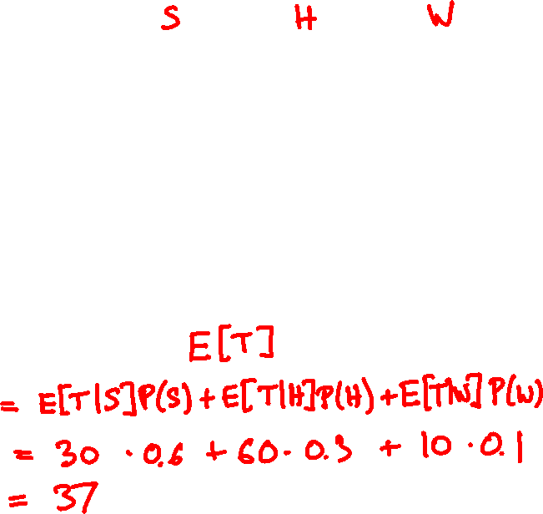
👩‍🏫 👵 🕵️‍♂️
type
average time
on facebook
30 min
60 min
10 min
% of visitors
60%
30%
10%
average visitor time =

Slide 13
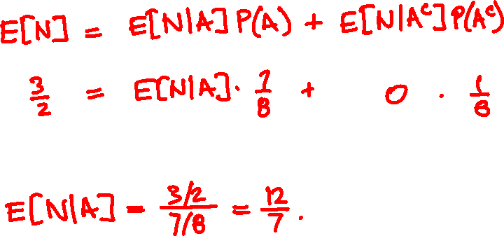
You flip 3 coins. What is the expected number of heads given that there is at least one?

Slide 14
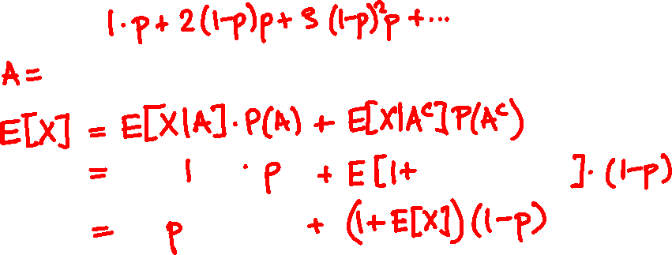
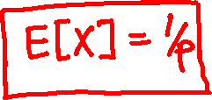

Mean of the Geometric
X = Geometric(p) random variable
E[X] =

Slide 15
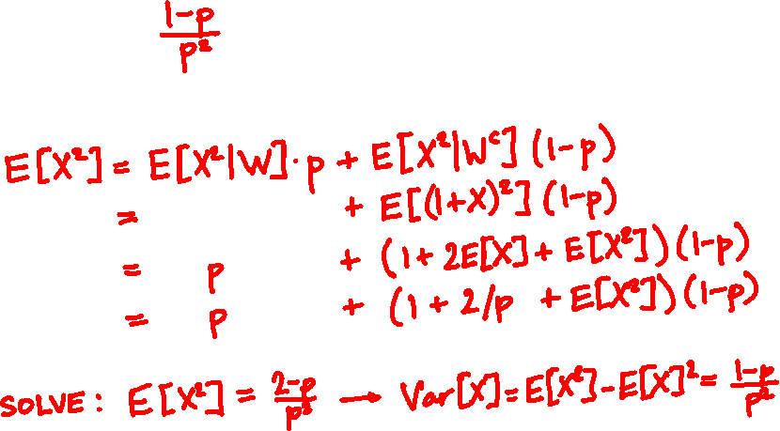

Variance of the Geometric
X = Geometric(p) random variable
Var[X] =
Proof (optional):

Slide 16
Geometric(0.5)
Geometric(0.7)
Geometric(0.05)

Slide 17

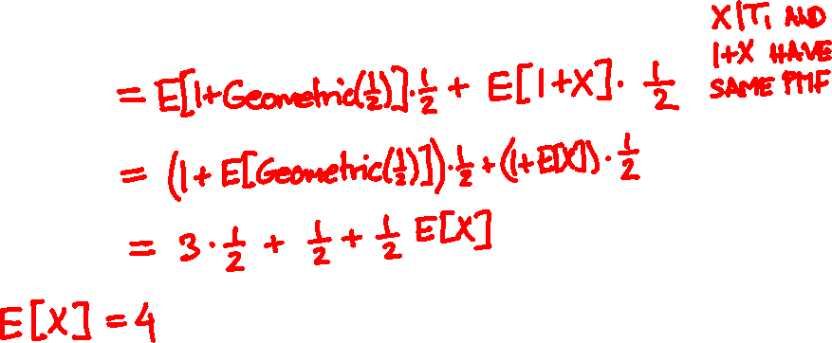

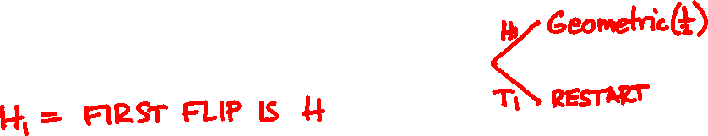
What is the expected number of coin flips until HT?

Slide 18
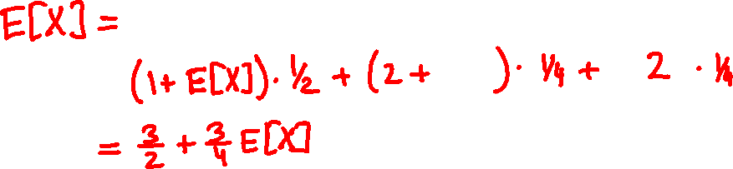
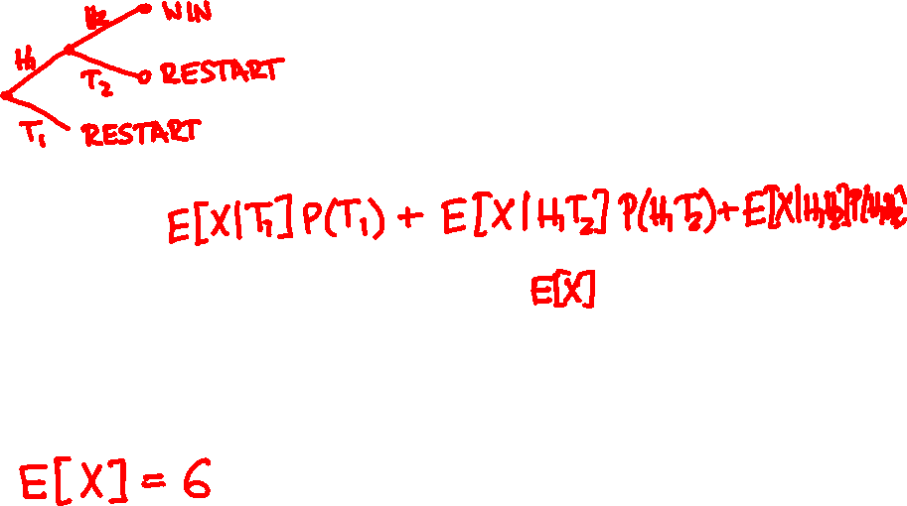
What is the expected number of coin flips until HH?

Slide 19
Independence
Let X be a discrete random variable, A an event.
X and A are independent if
P(X = x, A) = P(X = x) P(A)
for all possible values of x.

Slide 20
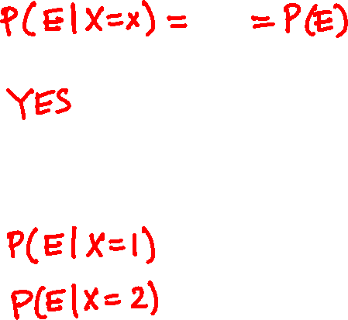
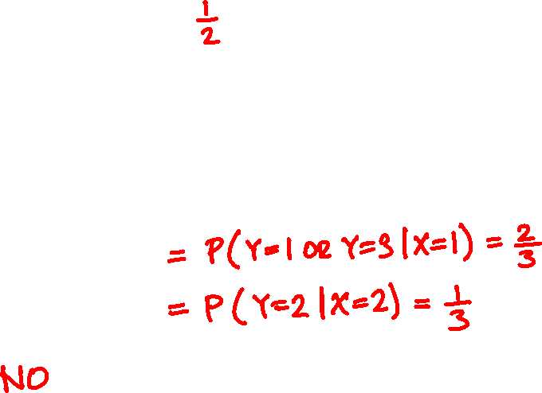
Let X, Y = face values of two 4-sided dice
E = “X + Y is even”. Are X and E independent?
What if the dice are 3-sided?

Slide 21
Independent random variables
Let X and Y be discrete random variables.
X and Y are independent if
P(X = x, Y = y) = P(X = x) P(Y = y)
for all possible values of x and y.
In PMF notation, p_{XY}(x, y) = p_{X}(x) p_{Y}(y) for all x, y.

Slide 22
Independent random variables
X and Y are independent if
P(X = x | Y = y) = P(X = x)
for all x and y such that P(Y = y) > 0.
In PMF notation, p_{X|Y}(x | y) = p_{X}(x) if p_{Y}(y) > 0.

Slide 23
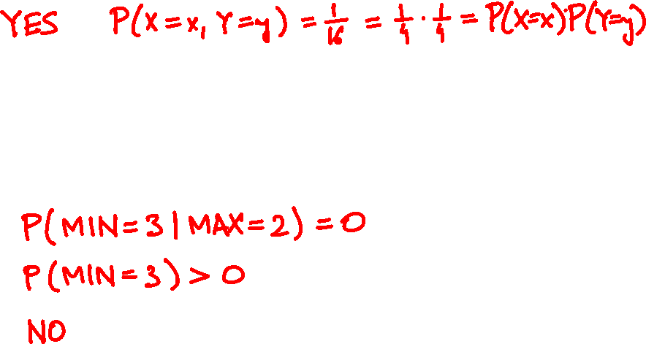
Let X, Y = face values of two 4-sided dice
Are X and Y independent?
How about MAX = max{X, Y} and MIN = min{X, Y}?

Slide 24
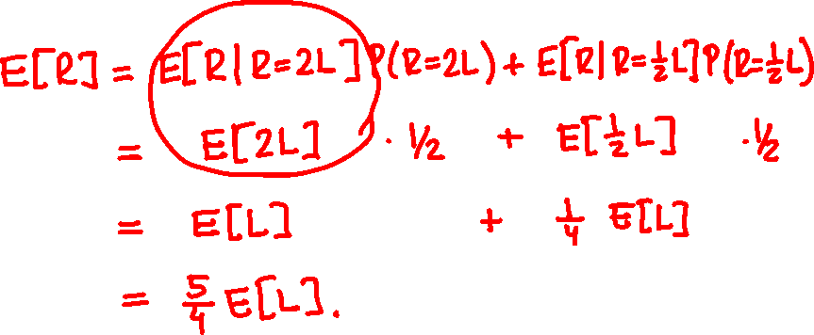
$x
$2x
👩‍💼
$2x
$x
🧧
🧧
left or right?

Slide 25
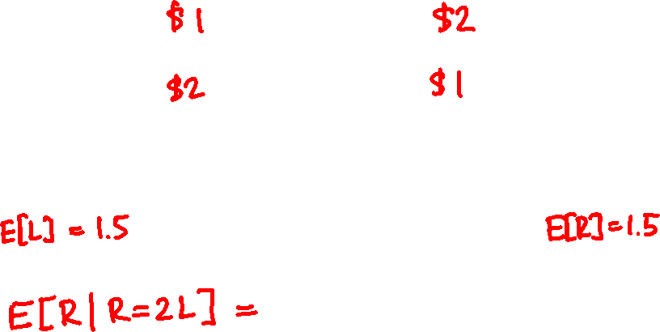
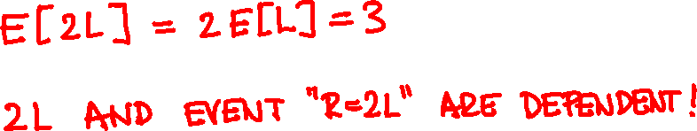

👩‍💼
🧧
🧧

Slide 26
Expectation and independence
X and Y are independent if and only if
E[f(X)g(Y)] = E[f(X)] E[g(Y)]
for all functions f and g.
If X and Y are independent then
E[XY] = E[X] E[Y]

Slide 27
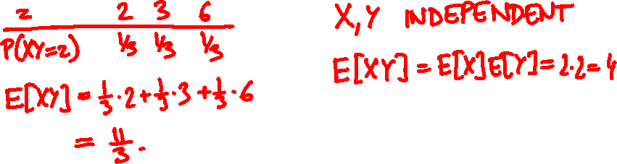
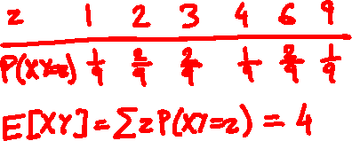
1
2
3
E[XY] = ?
without replacement
with replacement

Slide 28

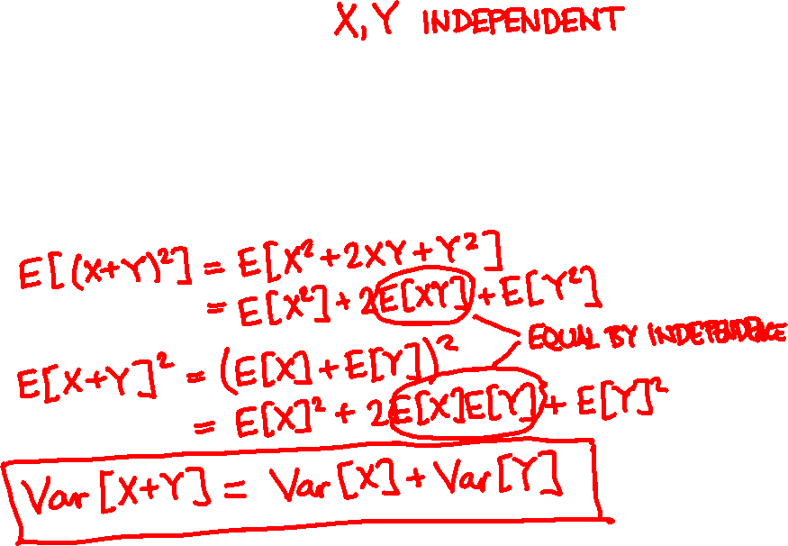
Variance of a sum
Recall Var[X] = E[(X – E[X])²] = E[X²] – E[X]²
Var[X + Y] =

Slide 29
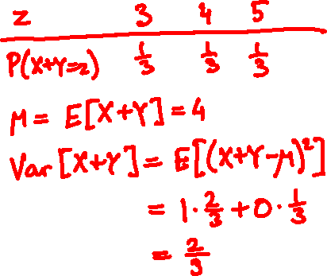
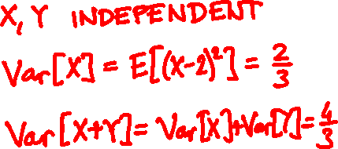
1
2
3
Var[X + Y] = ?
without replacement
with replacement

Slide 30
Variance of a sum
Var[X₁ + … + X_{n}] = Var[X₁] + … + Var[X_{n}]
if every pair X_{i}, X_{j} is independent.

Slide 31
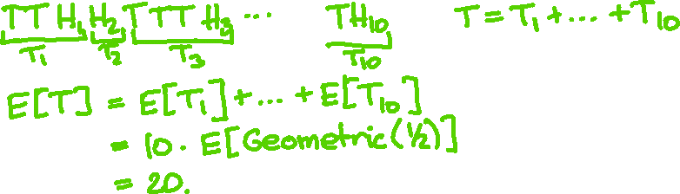
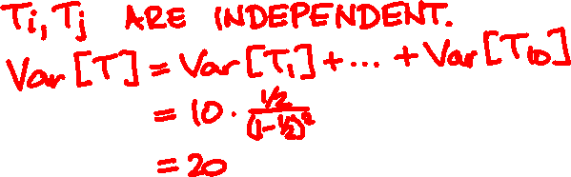
What is the expected number of coin flips until you collect 10 heads?
What is the variance?

Slide 32
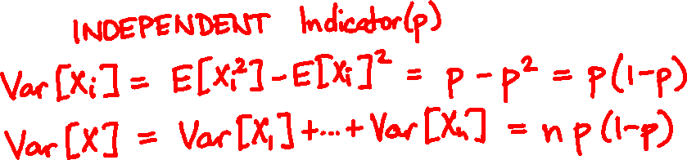
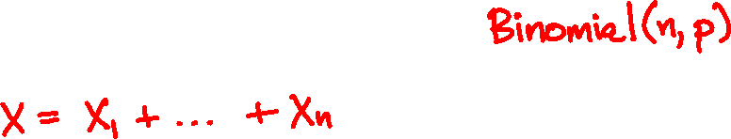
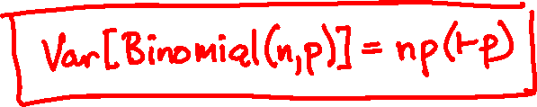
Variance of the Binomial

Slide 33
n = 1
n = 10
p = 0.35
n = 100
n = 1000

Slide 34
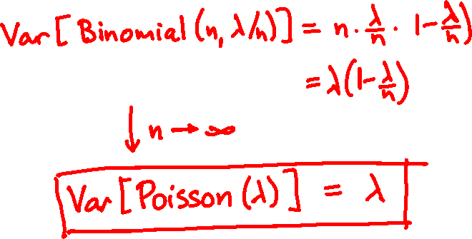


Variance of the Poisson

