Slide 1
4. Random Variables
ENGG 2760A / ESTR 2018: Probability for Engineers

Slide 2
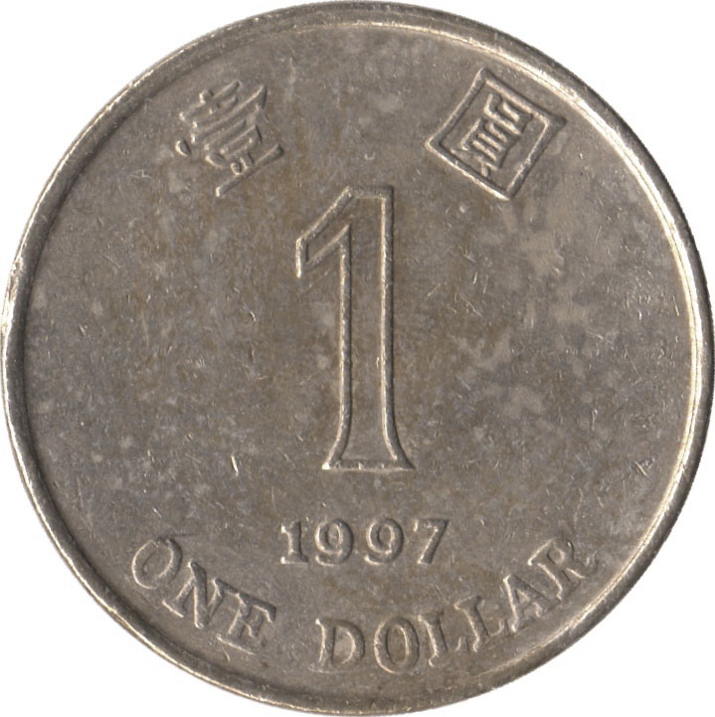
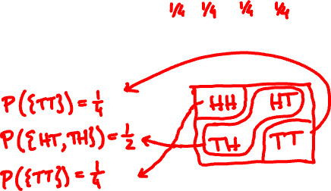
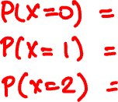
Random variable
A discrete random variable assigns a discrete value to every outcome in the sample space.
Example
{ HH, HT, TH, TT }
X = number of Hs

Slide 3
Probability mass function
The probability mass function of X is the function
p(x) = P(X = x)
We can describe the PMF by a table or by a chart.
x 0 1 2
p(x)
p(x) ¼ ½ ¼
x

Slide 4
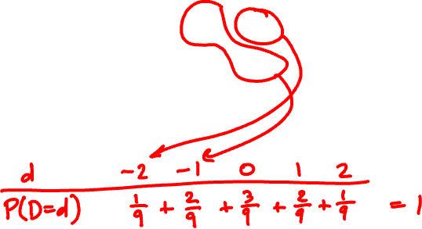
Two 3-sided dice are tossed. Calculate the PMF of the difference D of the rolls.
11 12 13
21 22 23
31 32 33

Slide 5
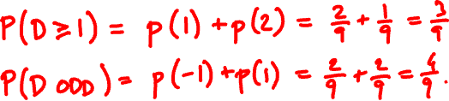
What is the probability that D ≥ 1? D is odd?

Slide 6


The binomial random variable
Binomial(n, p): Perform n independent trials, each of which succeeds with probability p.
X = number of successes
Examples
Toss n coins. “number of heads” is Binomial(n, ½).
Toss n dice. “Number of s” is Binomial(n, 1/6).

Slide 7
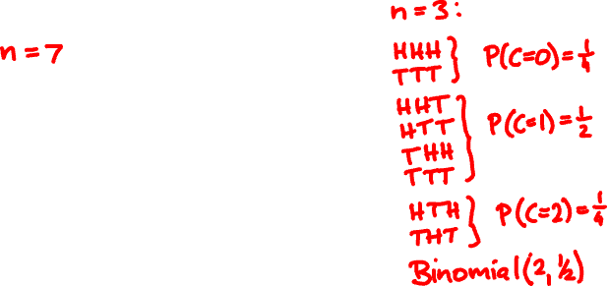
A less obvious example
Flip n coins. Let C be the number of consecutive changes (HT or TH).
Examples:
ω
C
HHHHHHH
0
THHHHHT
2
HTHHHHT
3
Then C is Binomial(n – 1, ½).

Slide 8
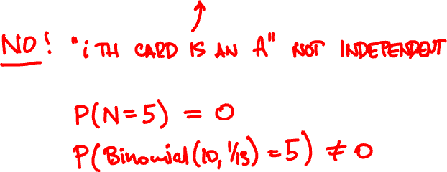
Draw a 10-card hand from a 52-card deck.
Let N = number of aces among the drawn cards
Is N a Binomial(10, 1/13) random variable?

Slide 9
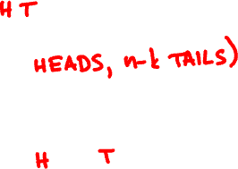
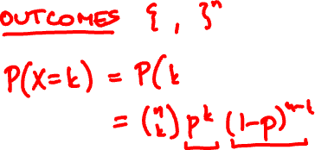
Probability mass function
If X is Binomial(n, p), its PMF is
n
(
)
p(k) = P(X = k) = p^{k} (1 - p)^{n-k}
k

Slide 10
Binomial(10, 0.5)
Binomial(50, 0.5)
Binomial(10, 0.3)
Binomial(50, 0.3)

Slide 11

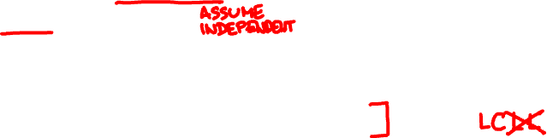

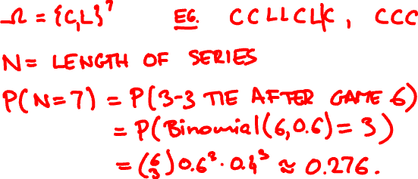

The Lakers and the Celtics meet for a 7-game playoff.
Lakers win 60% of the time. What is the probability that all 7 games are played?

Slide 12

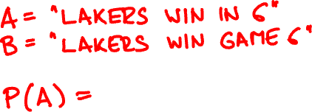

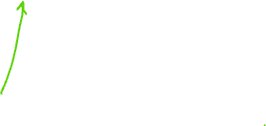
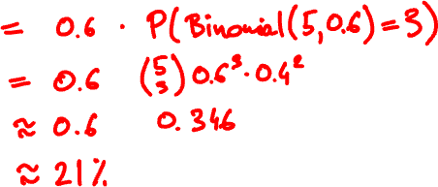
What is the probability that Lakers win in 6?
https://stattrek.com/online-calculator/binomial.aspx

Slide 13
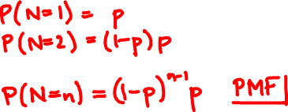
Geometric random variable
Let X₁, X₂, … be independent trials with success p.
A Geometric(p) random variable N is the time of the first success among X₁, X₂, … :
N = first (smallest) n such that X_{n} = 1.

Slide 14
Geometric(0.5)
Geometric(0.7)
Geometric(0.05)

Slide 15
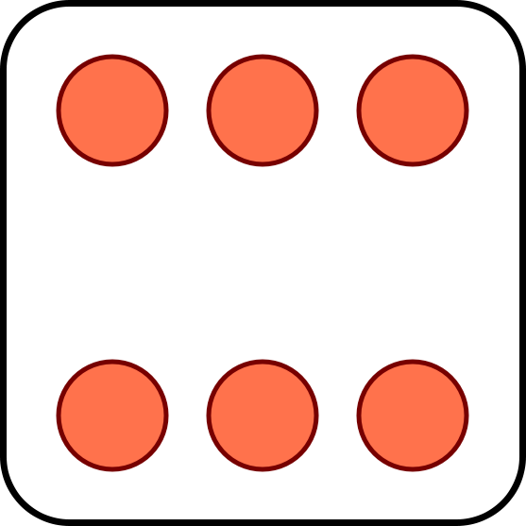

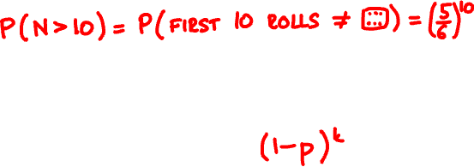
You keep rolling until you roll a . What is the probability that you rolled more than 10 times?
P(Geometric(p) > k) =

Slide 16
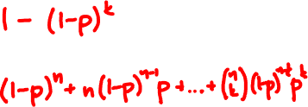
Cumulative distribution function
The cumulative distribution function of X is
F(x) = P(X ≤ x)
P(Geometric(p) ≤ k) =
P(Binomial(n, p) ≤ k) =

Slide 17
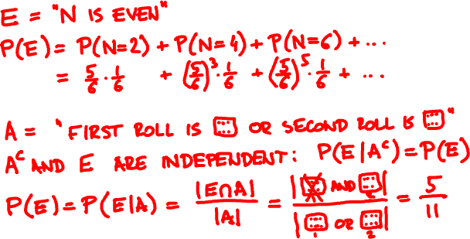

You keep rolling until you roll a . What is the probability that you rolled an even number of times?

Slide 18
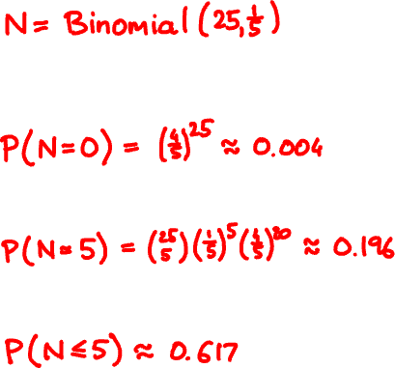
Alice randomly sprinkles 25 chocolate chips on 5 cookies. How many chips does a cookie get?
What is the probability a cookie gets no chips?
exactly 5 chips?
at most 5 chips?

Slide 19
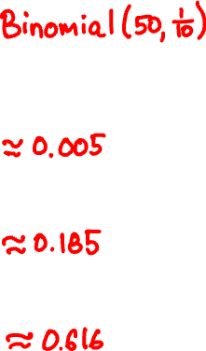
Alice randomly sprinkles 50 chocolate chips on 10 cookies. How many chips does a cookie get?
What is the probability a cookie gets no chips?
exactly 5 chips?
at most 5 chips?

Slide 20
Binomial(25, .2)
 | P(X = 0) | P(X = 5) | P(X ≤ 5)
Binomial(25, .2) | 0.004 | 0.196 | 0.617
Binomial(50, .1) | 0.005 | 0.185 | 0.616
Binomial(500, .01) | 0.006 | 0.176 | 0.615
Poisson(5)
Binomial(50, .1)
Poisson(5)

Slide 21
The Poisson random variable
A Poisson(λ) random variable has PMF
p(k) = e^{-λ} λ^{k}/k!
k = 0, 1, 2, 3, …
How many…
… chocolate chips on a cookie?
… raindrops fall on your head in next sec?
... buses arrive in the next hour?
https://homepage.divms.uiowa.edu/~mbognar/applets/pois.html

Slide 22

Poisson as limit of Binomial
Poisson(λ) approximates Binomial(n, p)
when λ = np is fixed and n is large (p is small)
P(Poisson(λ) = k) = lim_{n → ∞} P(Binomial(n, λ/n) = k)
More generally, for any event A
P(Poisson(λ) ∈ A) = lim_{n → ∞} P(Binomial(n, λ/n) ∈ A)

Slide 23


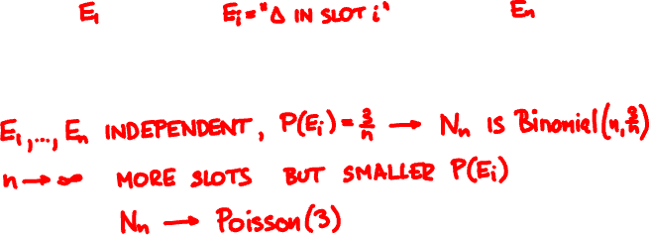
Poisson as limit of Binomial
Rain is falling on your head at a rate of 3 drops/sec.
0
1

Slide 24
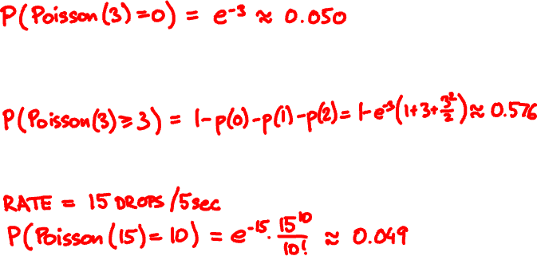
Rain falls at a rate of 3 drops/sec. What is the probability that you get
no hits in the next second?
at least 3 hits in the next second?
exactly 10 hits in the next 5 seconds?

