Slide 1
3. Conditional Probability and Independence

Slide 2
Total probability theorem
F
F^{c}
P(E)
= P(E∩F) + P(E∩F^{c})
Ω
E
= P(E|F)P(F) + P(E|F^{c})P(F^{c})
F₃
F₄
F₁
More generally, if F₁,…, F_{n}
partition Ω then
E
F₂
F₅
P(E) = P(E|F₁)P(F₁) + … + P(E|F_{n})P(F_{n})

Slide 3
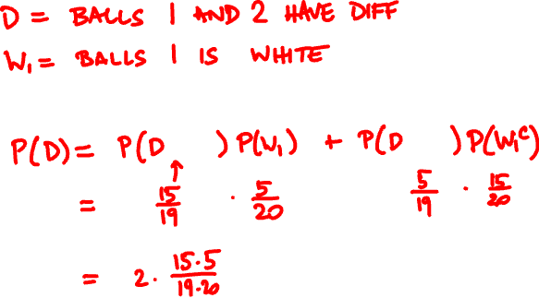


An urn has 5 white balls and 15 black balls. You draw two at random. What is the probability that their colors are different?

Slide 4

Multiple choice quiz
What is the capital of N Macedonia?
A: Sofia
B: Sevres
C: Skopje
D: Seoul
Did you know or were you lucky?

Slide 5
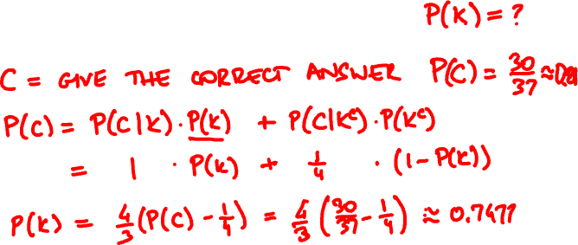
Multiple choice quiz
Probability model
There are two types of students:
Type K: Knows the answer
Type K^{c}: Picks a random answer

Slide 6
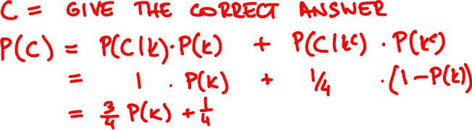


Multiple choice quiz
Probability model
There are two types of students:
Type K: Knows the answer
Type K^{c}: Picks a random answer

Slide 7

1
2
3
I choose a cup at random and then a random ball from that cup. The ball is red. You need to guess where the ball came from.
Which cup would you guess?

Slide 8
Cause and effect
1
2
3
cause:
C₁
C₂
C₃
effect:
R

Slide 9
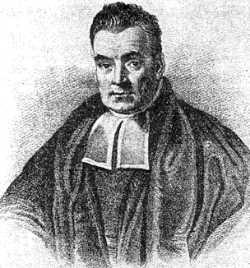
Bayes’ rule
P(E|C) P(C)
P(E|C) P(C)
P(C|E) =
=
P(E)
P(E|C) P(C) + P(E|C^{c}) P(C^{c})
More generally, if C₁,…, C_{n} partition S then
P(E|C_{i}) P(C_{i})
P(C_{i}|E) =
P(E|C₁) P(C₁) + … + P(E|C_{n}) P(C_{n})

Slide 10
Cause and effect
1
2
3
cause:
C₁
C₂
C₃
effect:
R
P(R|C_{i}) P(C_{i})
P(C_{i}|R) =
P(R|C₁) P(C₁) + P(R|C₂) P(C₂) + P(R|C₃) P(C₃)

Slide 11
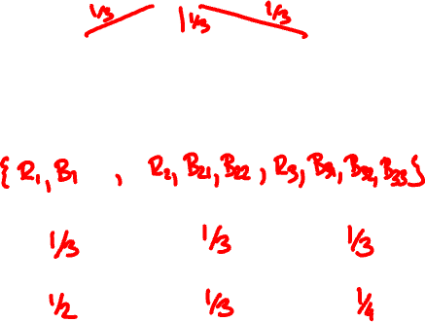
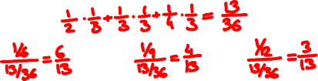
Cause and effect
1
2
3
Ω =
P(C_{i}) =
P(R|C_{i}) =
P(R) =
P(C_{i} |R) =

Slide 12
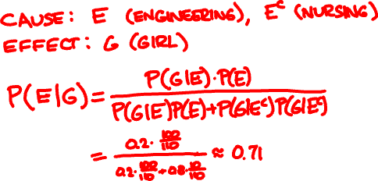
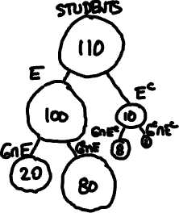
Two classes take place in Lady Shaw Building.
ENGG2430 has 100 students, 20% are girls.
NURS2400 has 10 students, 80% are girls.
A girl walks out. What are the chances that she is from the engineering class?

Slide 13
Summary of conditional probability
Conditional probabilities are used:
1
When there are causes and effects
to estimate the probability of a cause when we observe an effect
2
To calculate ordinary probabilities
Conditioning on the right event can simplify the description of the sample space

Slide 14
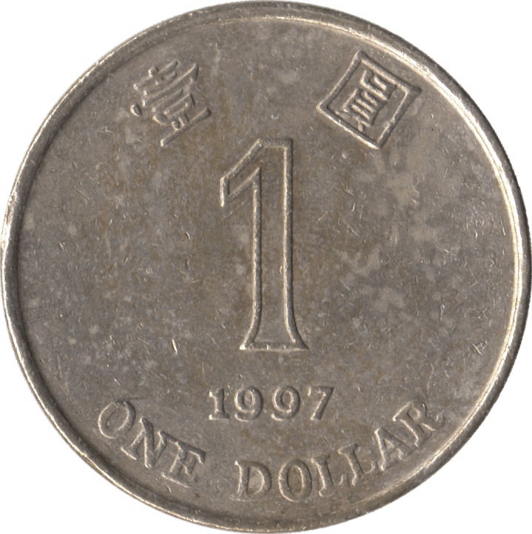
Independence of two events
Let E₁ be “first coin comes up H”
E₂ be “second coin comes up H”
Then P(E₂ | E₁) = P(E₂)
P(E₂∩E₁) = P(E₂)P(E₁)
Events A and B are independent if
P(A∩B) = P(A) P(B)

Slide 15

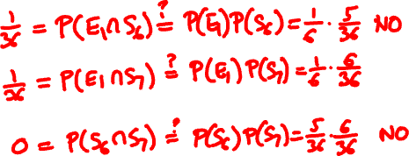
Examples of (in)dependence
Let E₁ be “first die is a 4”
S₆ be “sum of dice is a 6”
S₇ be “sum of dice is a 7”
E₁ and S₆?
E₁ and S₇?
S₆ and S₇?
Notes:
0

Slide 16
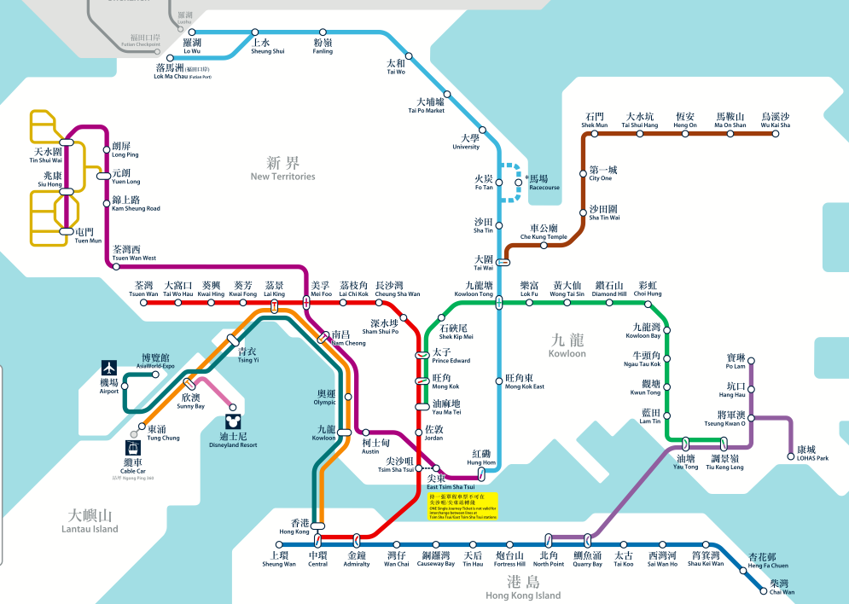

Sequential components
ER: “East Rail Line is working”
P(ER) = 70%
MS: “Ma On Shan Line is working”
P(MS) = 98%

Slide 17
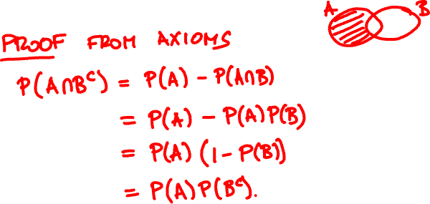
Algebra of independent events
If A and B are independent, then A and B^{c} are also independent.

Slide 18

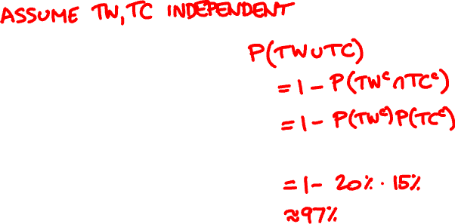
Parallel components
TW: “Tsuen Wan Line is operational”
P(TW) = 80%
TC: “Tung Chung Line is operational”
P(TC) = 85%

Slide 19
Independence of three events
Events A, B, and C are independent if
P(A∩B) = P(A) P(B)
P(B∩C) = P(B) P(C)
P(A∩C) = P(A) P(C)
and P(A∩B∩C) = P(A) P(B) P(C).

Slide 20
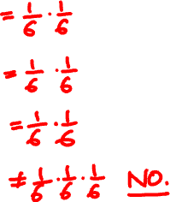

(In)dependence of three events
Let E₁ be “first die is a 4”
E₂ be “second die is a 3”
S₇ be “sum of dice is a 7”
1/6
E₁, E₂?
E₁
E₁, S₇?
1/36
E₂
S₇
E₂, S₇?
1/6
1/6
E₁, E₂, S₇?
Notes:
This example shows pairwise independence not enough for independence

Slide 21
Independence of many events
Events A₁, A₂, … are independent if for every subset of the events, the probability of the intersection is the product of their probabilities.
Algebra of independent events
Independence is preserved if we replace some event(s) by their complements, intersections, unions

Slide 22

Multiple components
P(ER) = 70%
P(WR) = 75%
P(TW) = 85%
P(KT) = 95%

Slide 23
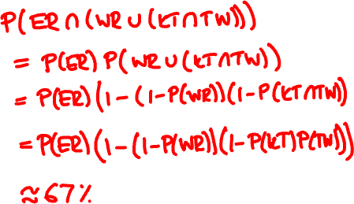
Multiple components
P(ER) = 70%
P(WR) = 75%
P(KT) = 95%
P(TW) = 85%

Slide 24


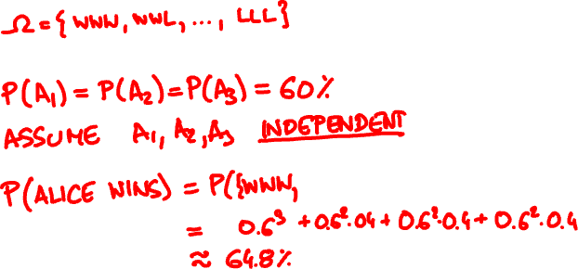

Alice wins 60% of her ping pong matches against Bob. They meet for a 3 match playoff. What are the chances that Alice will win the playoff?
Probability model
Notes:
Point out without proof that this is a valid definition of a probability model: You can calculate the probability of any outcome, and this is consistent with the axioms of probability

Slide 25
Conditional independence
A and B are independent conditioned on F if
P(A ∩ B | F) = P(A | F) P(B | F)
Alternative definition:
P(A | B ∩ F) = P(A | F)

Slide 26


today
tomorrow
☀️
80% ☀️, 20% 🌧
🌧
40% ☀️, 60% 🌧
It is ☀️ on Monday. Will it 🌧 on Wednesday?

Slide 27
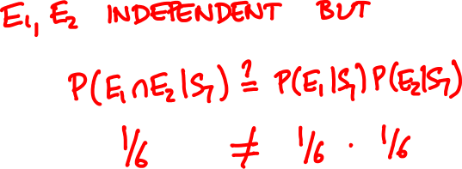
Independence ⇏ conditional independence
Let E₁ be “first die is a 4”
E₂ be “second die is a 3”
S₇ be “sum of dice is a 7”
Notes:
E1, E2 are independent, but dependent conditioned on S7

Slide 28


Slide 29
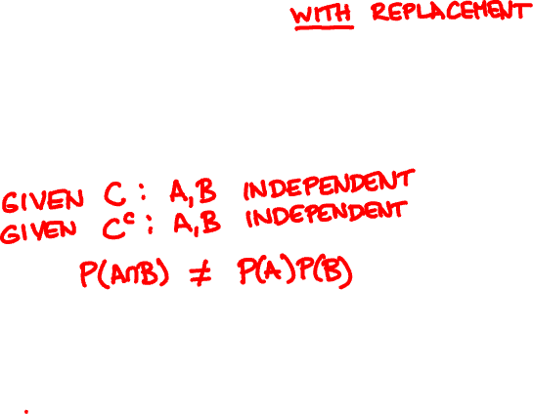
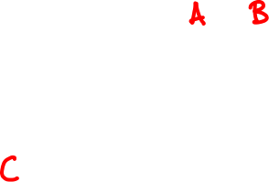
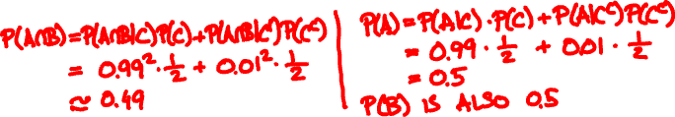
Conditional independence ⇏ independence
Probability model
🙎🏻‍♂️
🙍🏻‍♀️
🇺🇸
👍
👍
99%
1%
🇨🇳
👎
👎
Notes:
The events A = “Alice likes the movie” and B = ”Bob likes the movie” are conditionally independent, but unconditionally dependent
P(A and B) = ½ * .99^2 + ½ * .01^2 very close to ½, P(A) = P(B) = 1/2

