Slide 1
4. NUMBERS
CSI 2101: Discrete Structures
Andrej Bogdanov

Slide 2


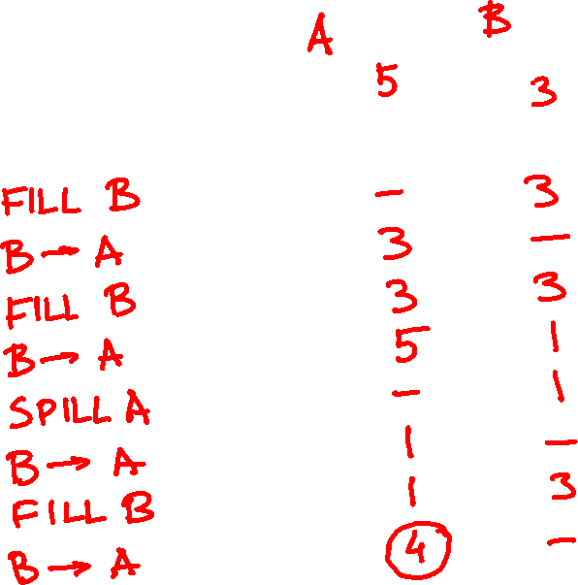

Slide 3
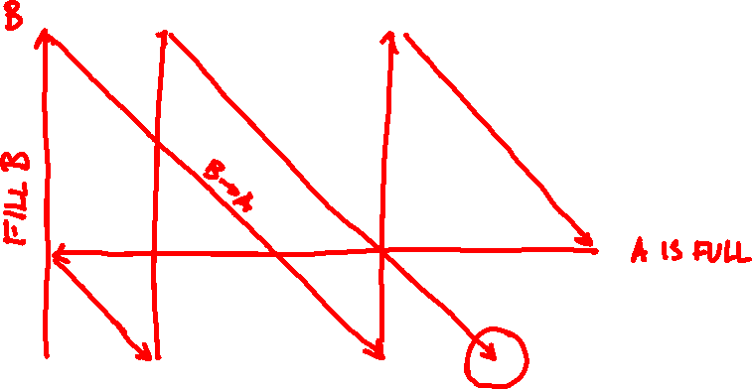

Slide 4

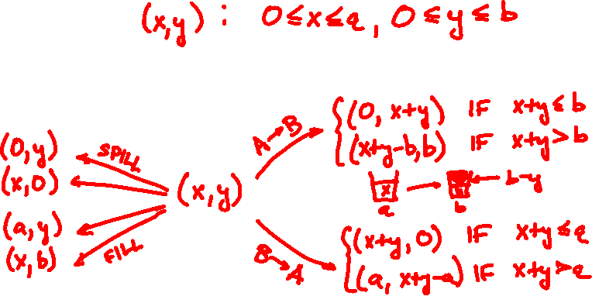
73l , 50l → 4l ?
9l , 6l → 4l ?
1147l , 899l → 999l ?
states:
transitions:

Slide 5
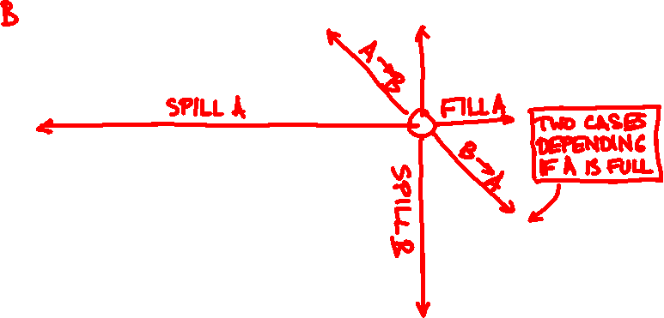

Slide 6
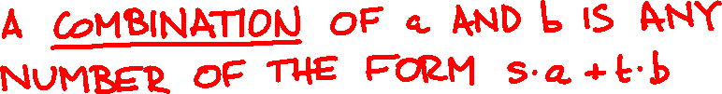
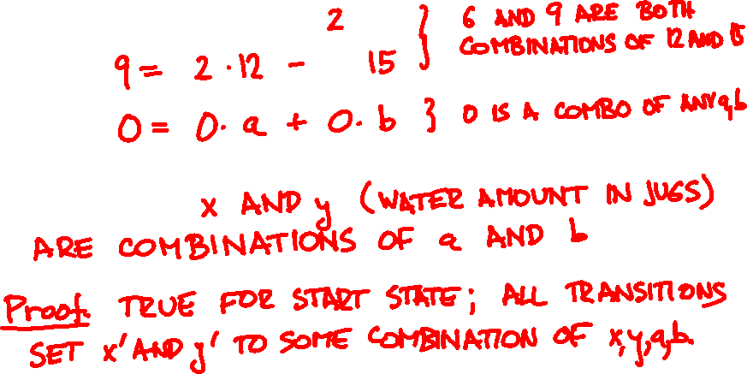

integer linear combinations
Invariant:

Slide 7
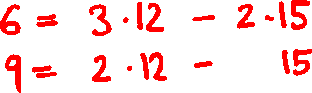
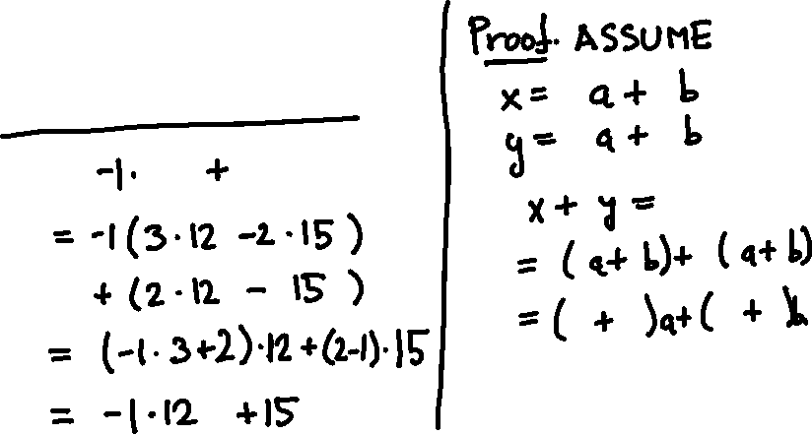
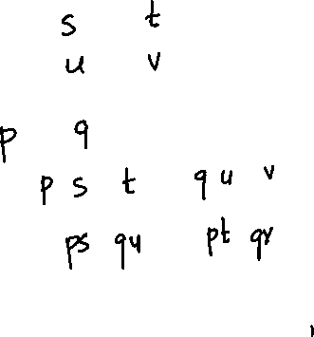

Lemma: Combinations of combinations of a and b are combinations of a and b

Slide 8
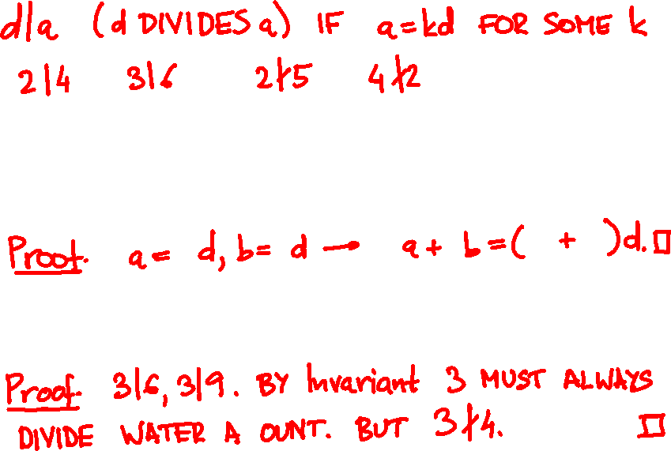


divisibility
Lemma: If d|a and d|b then d divides all combinations of a and b.
Corollary:

Slide 9
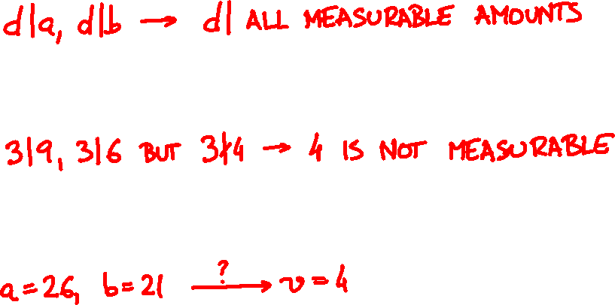
invariant recap
Water in each jug is combination of a and b
Can use it to show impossibility
Does not tell us what is possible

Slide 10

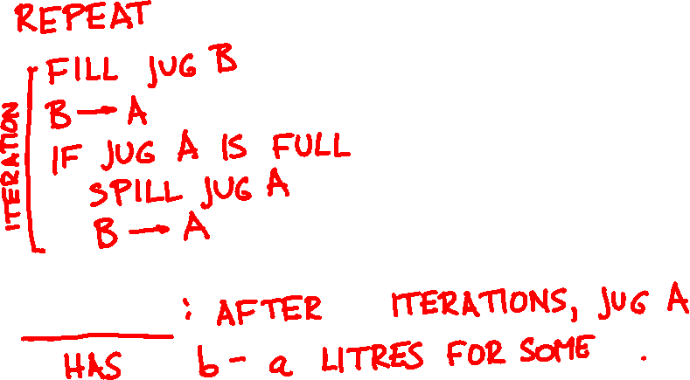
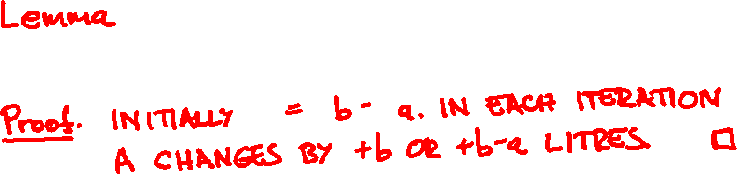

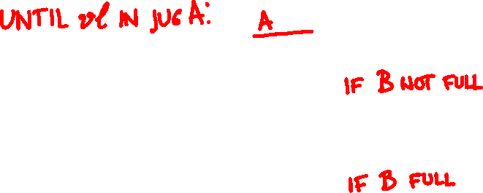

Die Hard: the algorithm

Slide 11
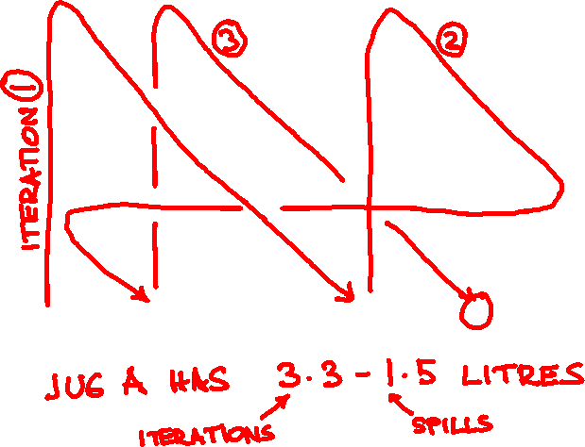

Slide 12
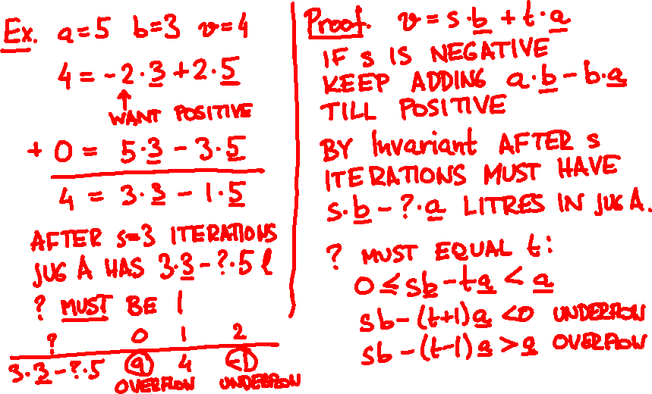
Lemma: If v is a combination of a and b then Bruce and Sam survive.

Slide 13
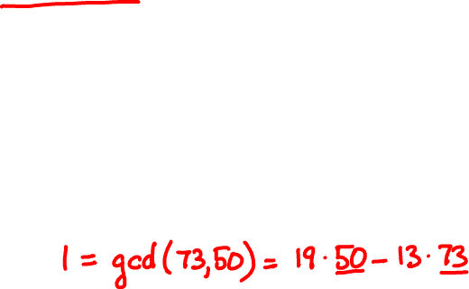
73l , 50l → 4l ?
9l , 6l → 4l ?
1147l , 899l → 999l ?
Important Theorem:
gcd(a, b) is a combination of a and b.

Slide 14
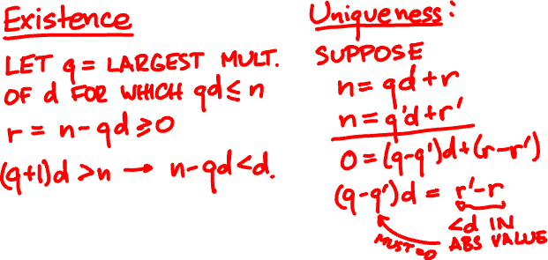
division with remainder
Theorem: For all n, d > 0 there exist unique q, 0 ≤ r < d such that n = qd + r.

Slide 15
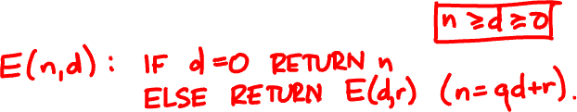
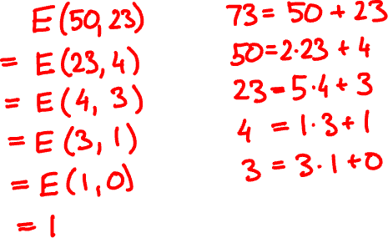
gcd and Euclid’s algorithm
E(73, 50) =

Slide 16
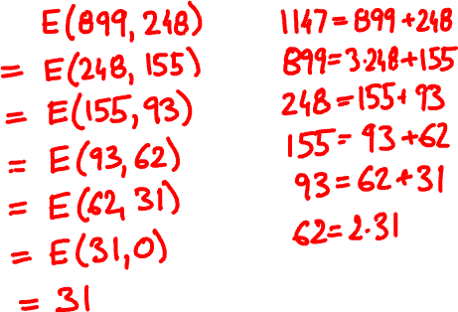
E(1147, 899) =

Slide 17
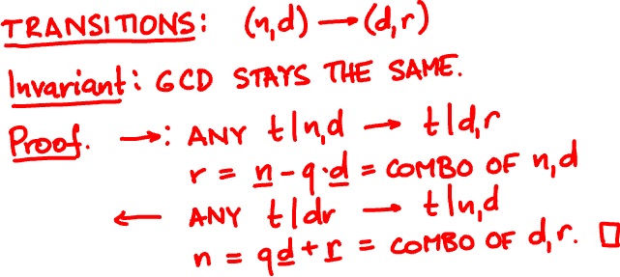
Theorem: Euclid’s algorithm always terminates and outputs the GCD.

Slide 18
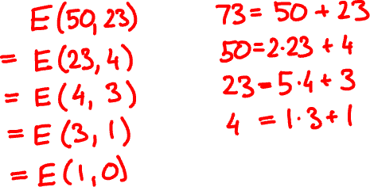
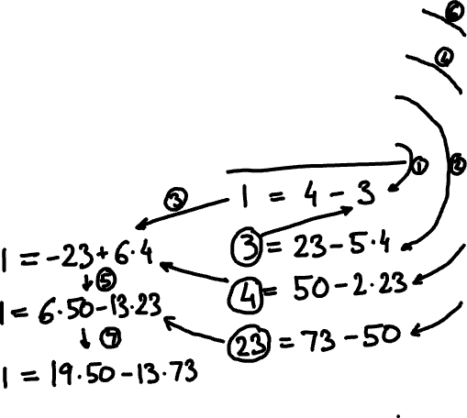
extended Euclid’s algorithm
E(73, 50) =

Slide 19
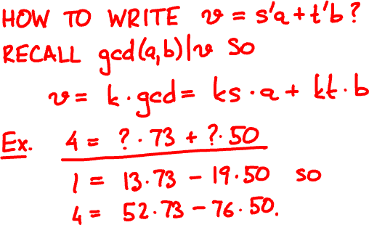
Theorem: Extended Euclid outputs s and t that satisfy sa + tb = gcd(a, b)

Slide 20
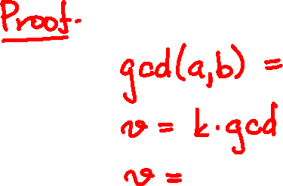

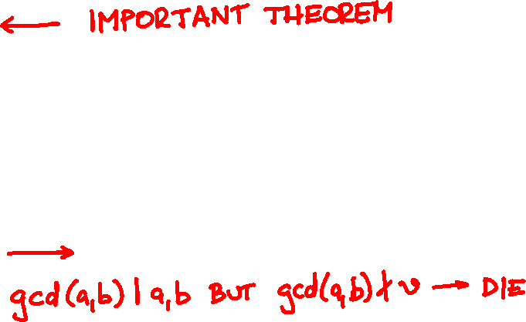
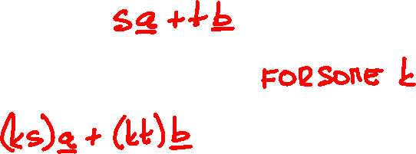
Corollary: Bruce and Sam survive if and only if v is a multiple of gcd(a, b).

Slide 21



prime factorization
Every number is a product of primes.
Fundamental Theorem of Arithmetic: The prime factorization is unique.

Slide 22
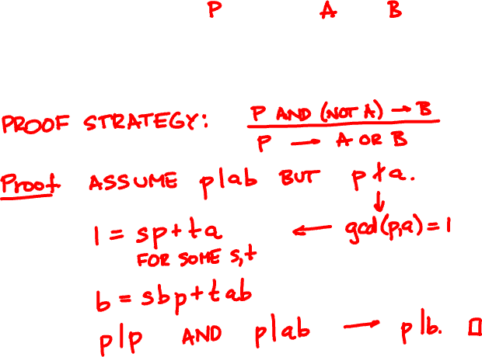
Lemma: If prime p|ab then p|a or p|b.

Slide 23
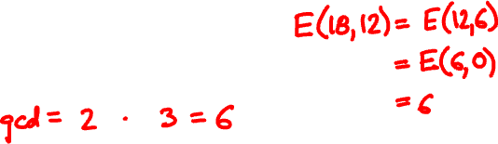

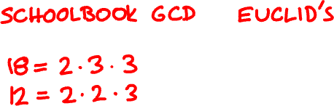

gcd and factorization

