Slide 1
2. PROOFS
CSI 2101: Discrete Structures
Andrej Bogdanov

Slide 2
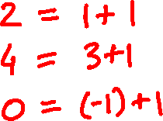

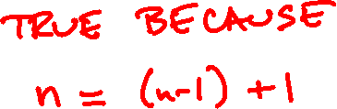
reasoning about quantifiers
(1)
Every even number is the sum of
two odd numbers.

Slide 3
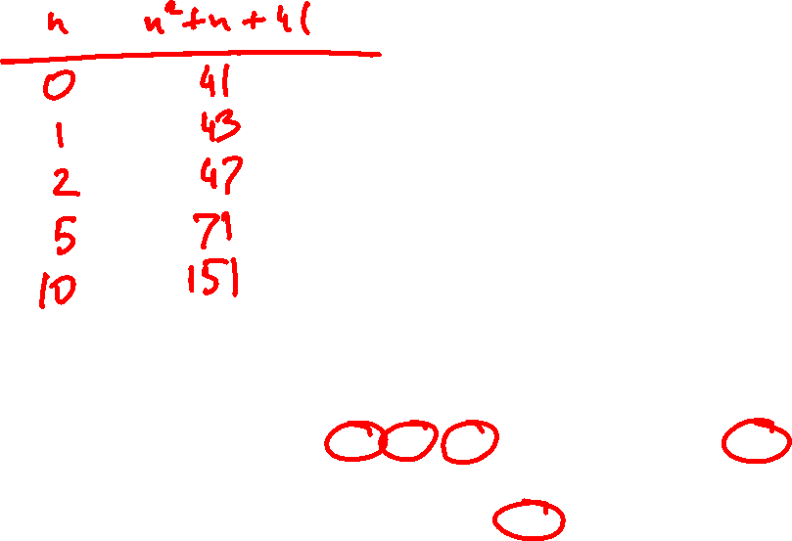
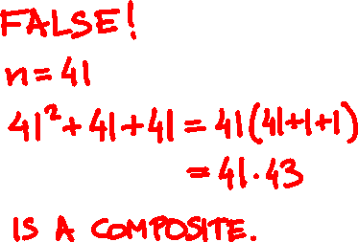

(2)
For every n ≥ 0, n² + n + 41 is a prime.
primes
2 | 3 | 5 | 7 | 11 | 13 | 17 | 19 | 23 | 29
31 | 37 | 41 | 43 | 47 | 53 | 59 | 61 | 67 | 71
73 | 79 | 83 | 89 | 97 | 101 | 103 | 107 | 109 | 113
127 | 131 | 137 | 139 | 149 | 151 | 157 | 163 | 167 | 173

Slide 4

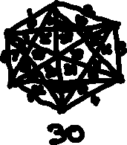
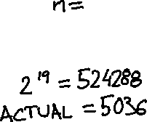
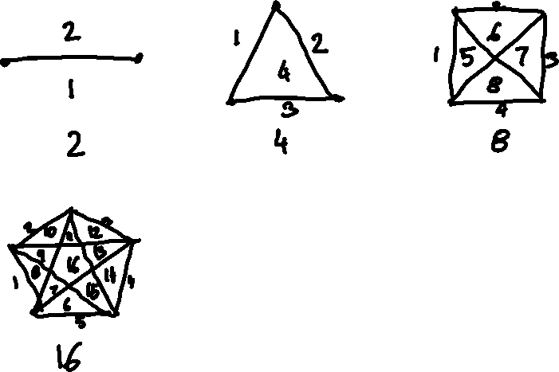
(3)
Inscribe a regular n-gon on a circle and draw all diagonals. How many regions are there?

Slide 5

(4a)
29 is the sum of three integer cubes.
(4b)
33 is the sum of three integer cubes.
33 = 8866128975287528³
+ (–8778405442862239)³
+ (–2736111468807040)³
A. Booker, Cracking the problem with 33, 2022

Slide 6
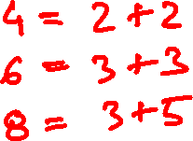
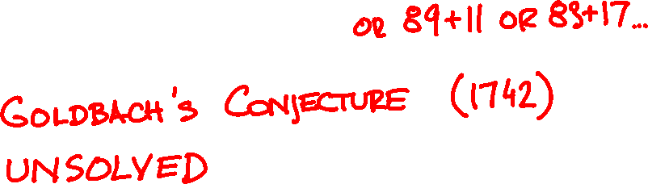
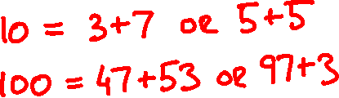
(5)
Every even number greater than 2 is the
sum of two primes.

Slide 7

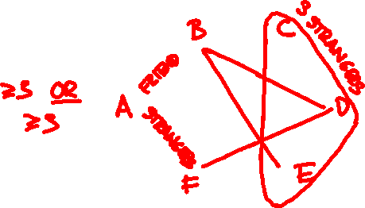
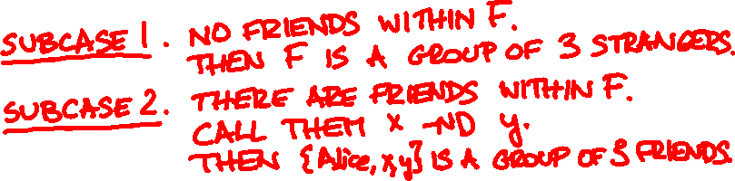
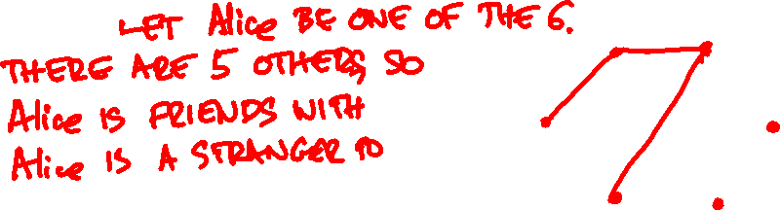
Theorem: Among any 6 people there is a group of 3 friends or a group of 3 strangers.
Proof:

Slide 8
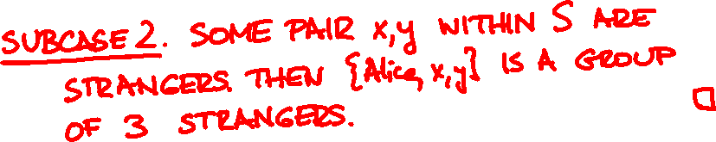


Slide 9
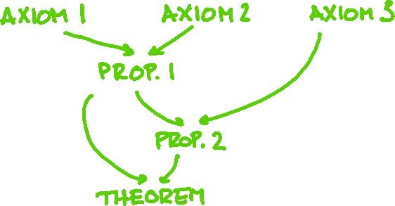
A proof is a sequence of deductions from axioms and already proved theorems that concludes with the proposition we want.
A theorem is a proposition that we (or someone else) already proved.

Slide 10
axioms
Axiom 1: If Alice is friends with Bob then Bob is friends with Alice
Axiom 2: If Alice is in a group of 6 people then there are 5 others

Slide 11

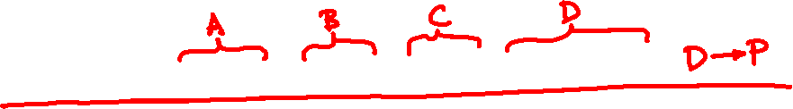

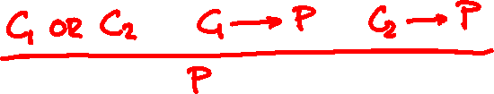
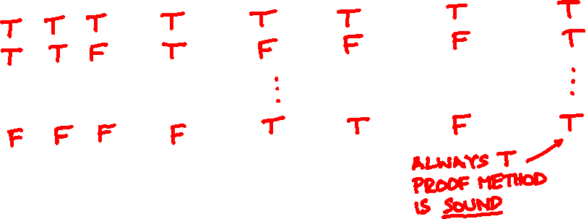
proof by cases

Slide 12
Proofs are easy to verify* but can be difficult to create.
There are famous propositions waiting for proofs even after 100+ years.
They are called conjectures.

Slide 13
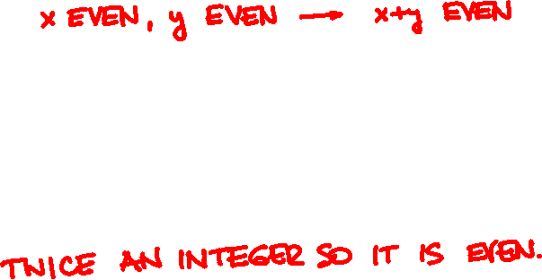
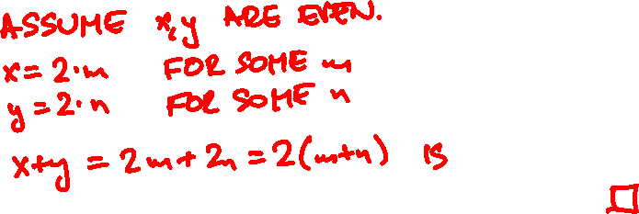
proving an implication
Theorem: The sum of even integers is even.
Proof:

Slide 14

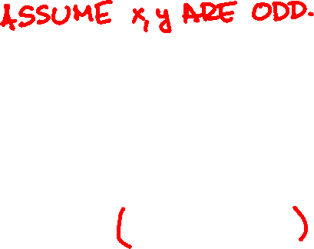
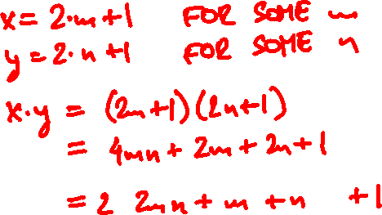
Theorem: The product of odd integers is odd.
Proof:

Slide 15
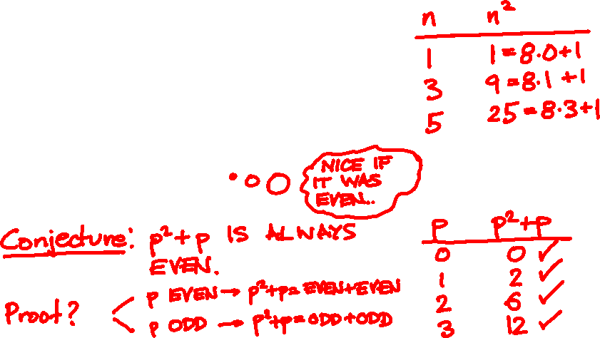
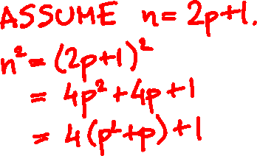
Theorem: The square of an odd number is of the form 8k + 1 for some integer k.
Proof:

Slide 16
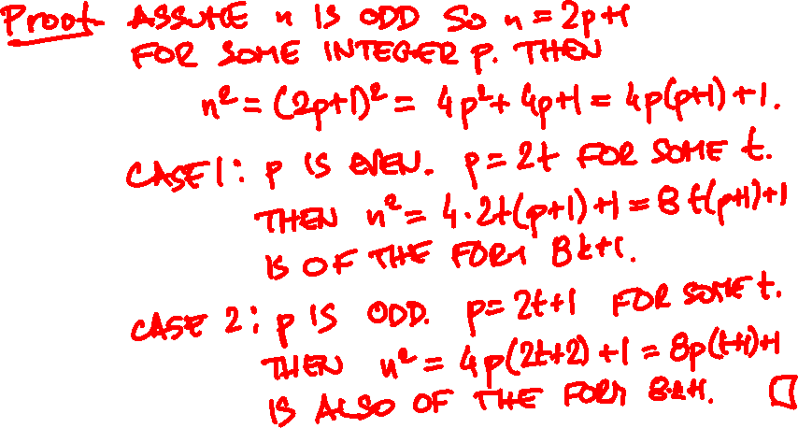

Slide 17
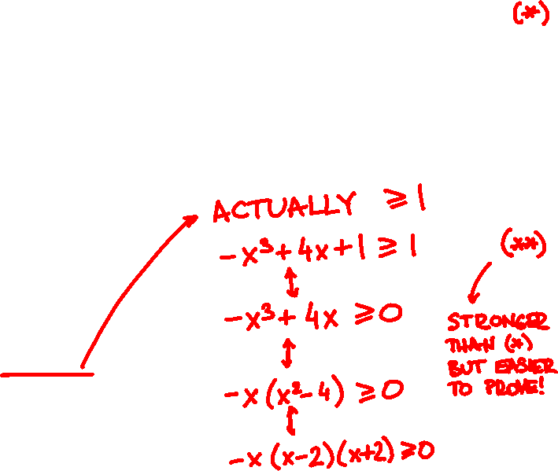
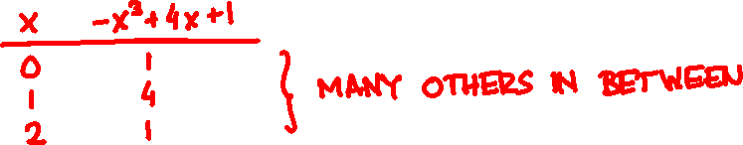
Theorem: If 0 ≤ x ≤ 2, then –x³ + 4x + 1 > 0.

Slide 18
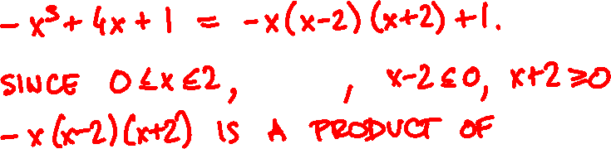
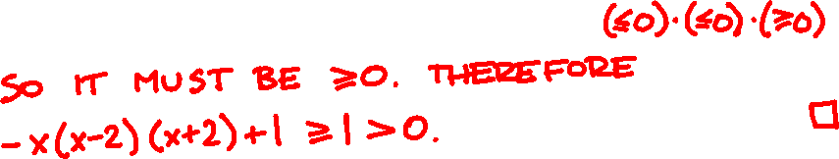

Slide 19
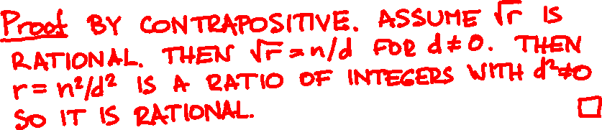
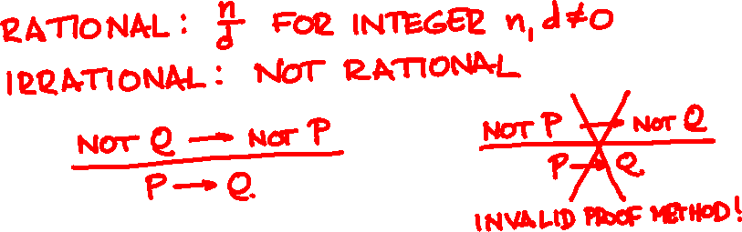
proof by contrapositive
Theorem: If r ≥ 0 is irrational then √r is irrational.

Slide 20

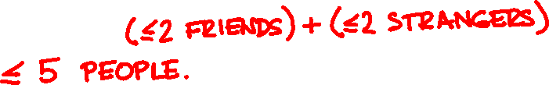
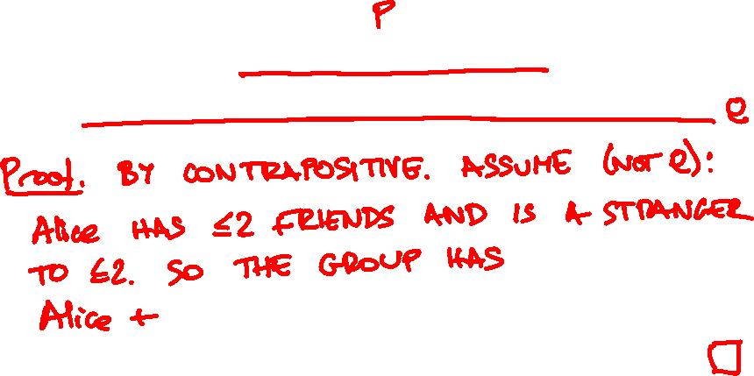
Lemma: In every group of six people including Alice, she has 3 friends or is stranger to some 3.

Slide 21

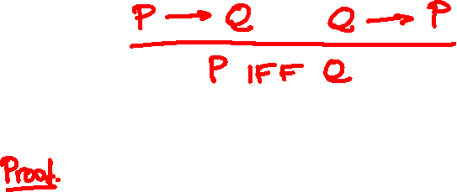

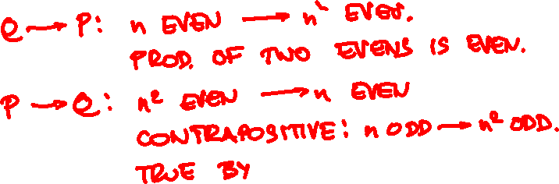
proving equivalences
Theorem: n² is even if and only if n is even.

Slide 22
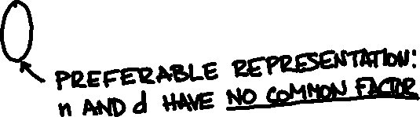

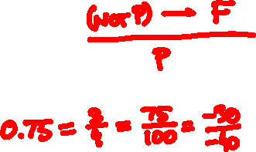
proof by contradiction
Theorem: √2 is irrational.

Slide 23
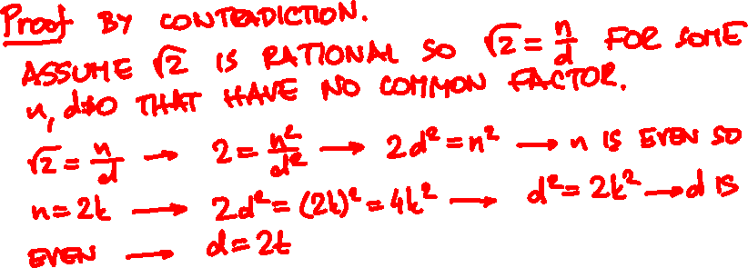
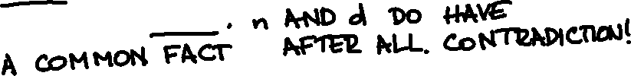

Slide 24
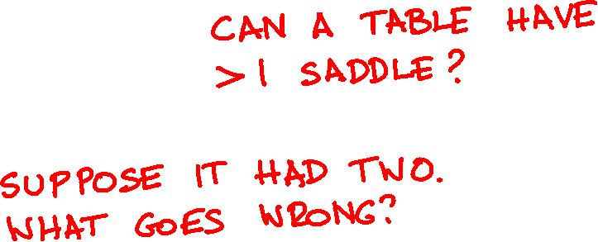
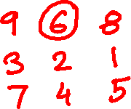
A table is filled with distinct numbers. A saddle is a number largest in its column and smallest in its row.

Slide 25
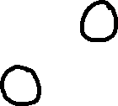

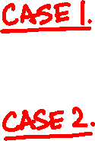
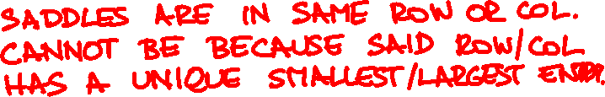
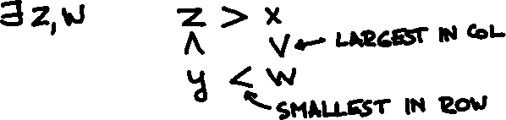
Theorem: A table can have at most one saddle.

Slide 26
A table is filled with distinct numbers. Sort the rows. Then sort the columns. Are the rows still sorted?

