Slide 1
1. LOGIC
CSI 2101: Discrete Structures
Andrej Bogdanov

Slide 2

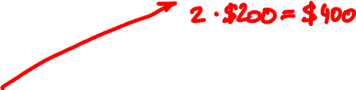
Friday
Monday
Elmoland
🚗
E
🚗🚗🚗🚗🚗🚗
Dogburg
🚗
🚗🚗
D
🚗🚗🚗🚗🚗🚗🚗
Catcity
🚗
C
Beantown
🚗
B
🚗🚗🚗🚗
🚗🚗🚗
Alphaville
🚗🚗

Slide 3
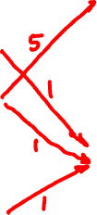
Which car should go where?
🚗
E
E
🚗🚗🚗🚗🚗🚗
🚗🚗
D
D
🚗
🚗🚗🚗🚗🚗🚗🚗
C
C
🚗
🚗
B
B
🚗🚗🚗🚗
🚗🚗🚗
A
A
🚗🚗

Slide 4

Can you do better?
🚗
E
E
🚗🚗🚗🚗🚗🚗
🚗🚗
D
D
🚗
🚗🚗🚗🚗🚗🚗🚗
C
C
🚗
🚗
B
B
🚗🚗🚗🚗
🚗🚗🚗
A
A
🚗🚗

Slide 5
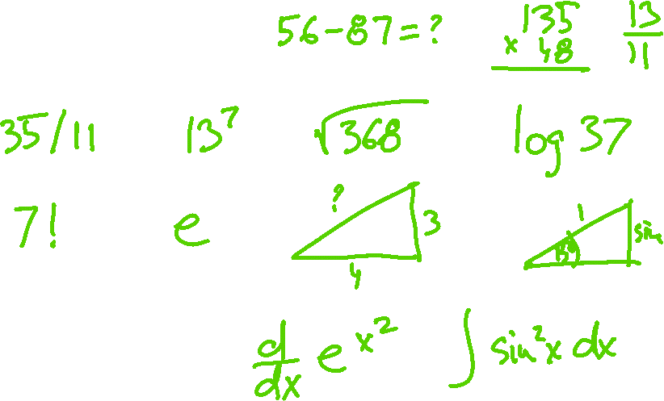
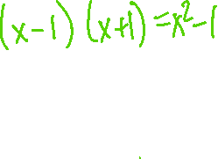
2 + 2 = ?

Slide 6

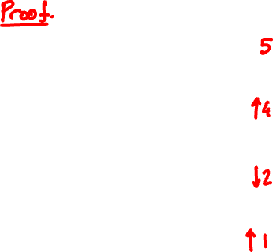
Cannot spend < $1200 because
🚗
E
🚗🚗🚗🚗🚗🚗
🚗🚗
D
🚗
🚗🚗🚗🚗🚗🚗🚗
C
🚗
🚗
B
🚗🚗🚗🚗
🚗🚗🚗
A
🚗🚗

Slide 7
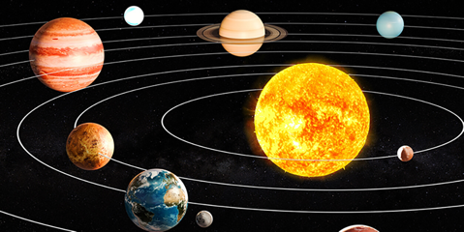
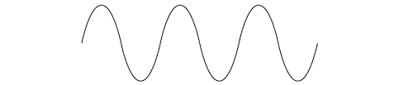
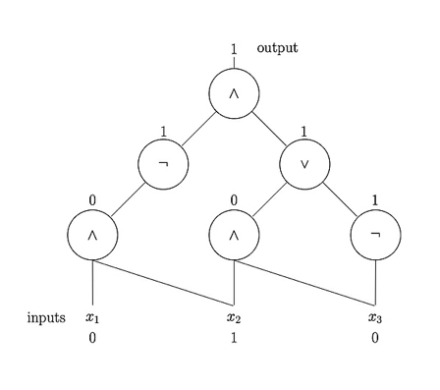
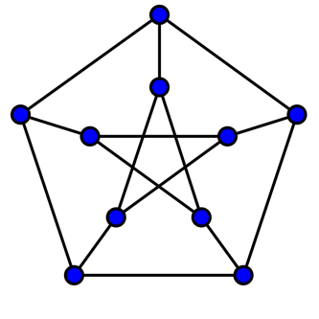
continuous
3.1415926535897932384626433…
discrete
100101010100101110101
42

Slide 8
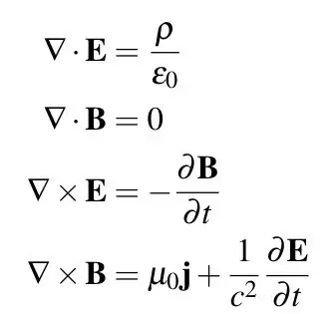
continuous
∫
e^{-x}dx
discrete
s = 0
for i in range(n):
s += i
return s
∞
∑
n⁻²
n = 1

Slide 9
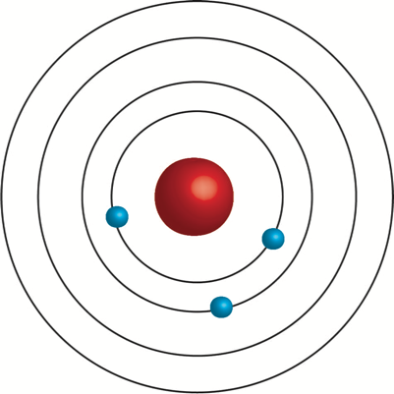
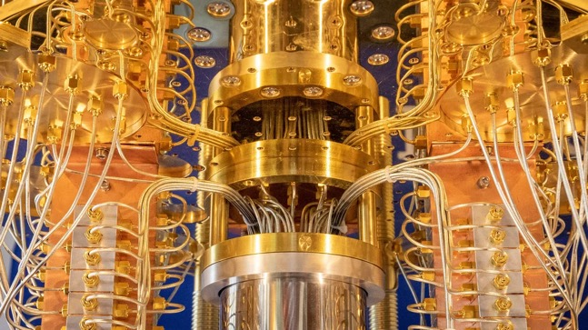

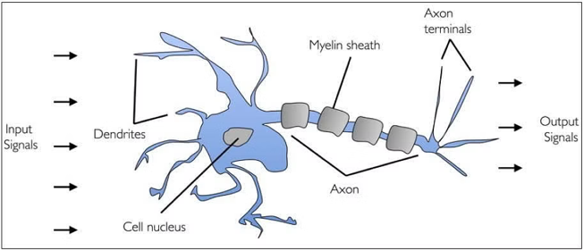

Slide 10
3
0 1 1 1
1 0 0 0
1 0 0 1
1 0 1 0
1
4
2

Slide 11
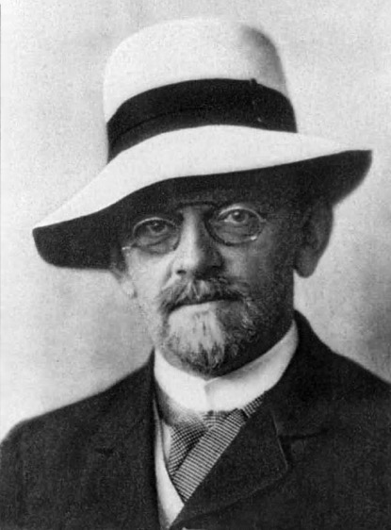
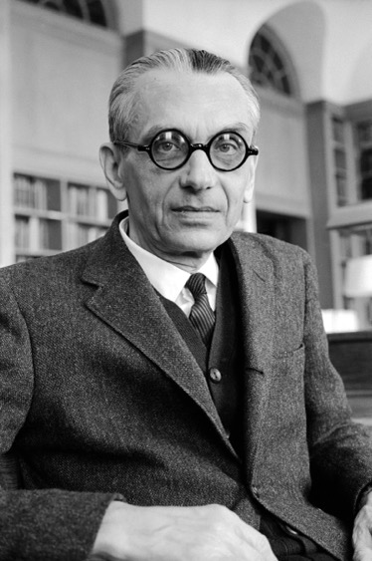
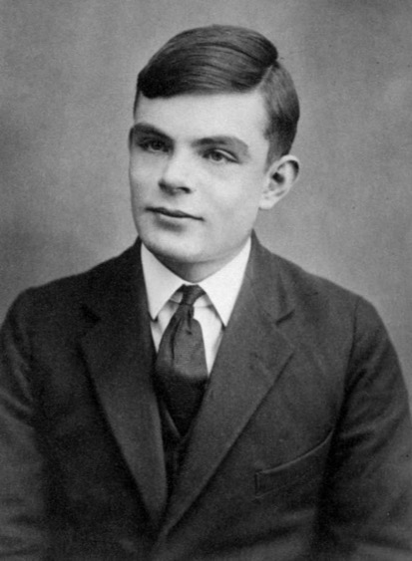
logic

Slide 12
propositions
1 + 1 = 3
1 + 1 = 2
axiomatic method
Start with some propositions that we all agree
are true: the axioms
Figure out the rest using the rules of logic

Slide 13
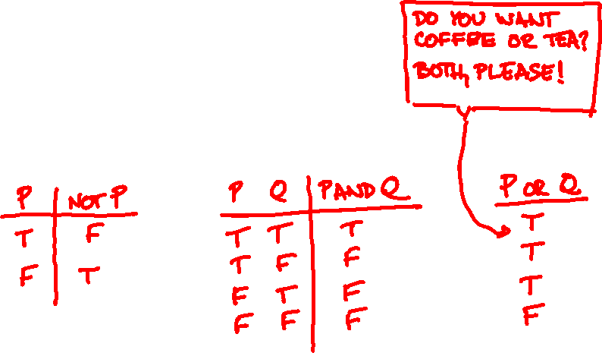
logical operators
NOT (1 + 1 = 3)
(1 + 1 = 2) AND (1 + 1 = 3)
truth tables
NOT
AND
OR

Slide 14
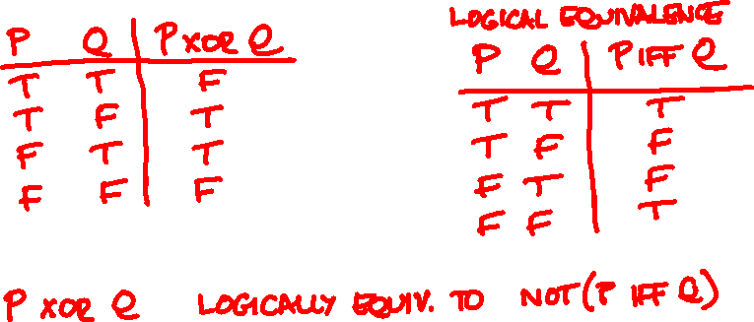
more truth tables
XOR
IFF
Every propositional formula is logically
equivalent to one that uses only AND, OR, NOT

Slide 15
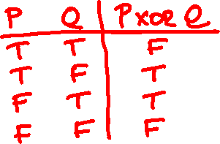
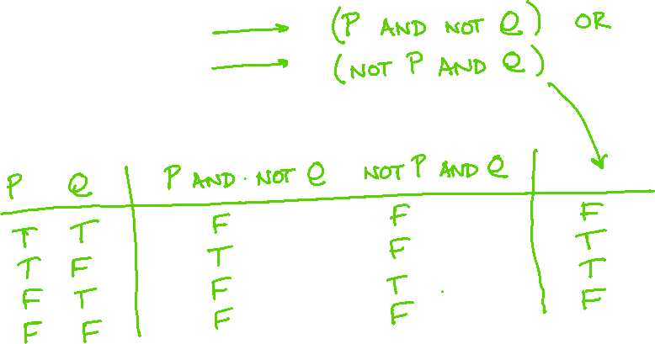
Example: P XOR Q

Slide 16
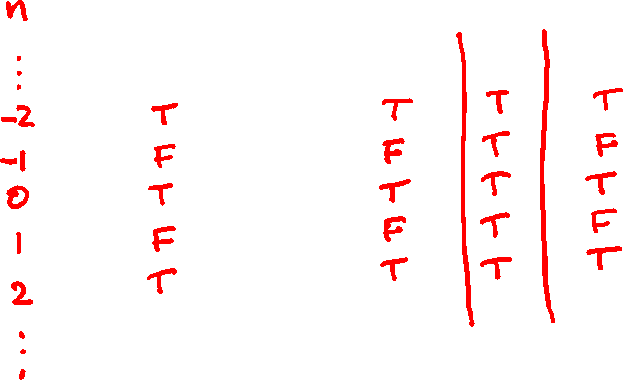
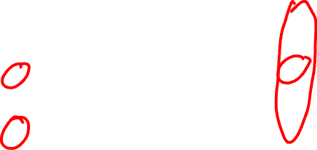
predicates
n is even
n is even IFF n + 2 is even

Slide 17
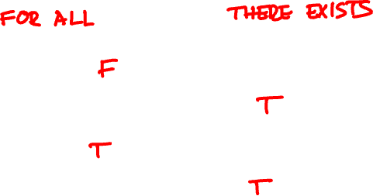
quantifiers
∀
∃
∀n: n is even
∀n: n is even IFF n + 2 is even
∃n: n is even
∃n: n is even IFF n + 2 is even

Slide 18
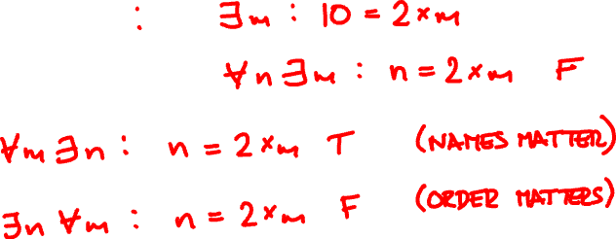
nested quantifiers
10 is even
∀n: n is even

Slide 19
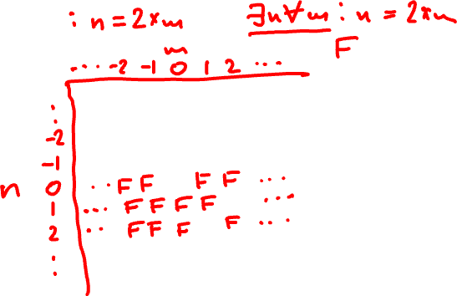

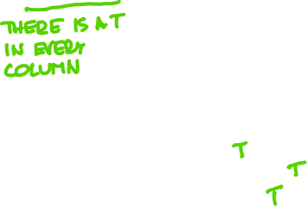
nested quantifiers

Slide 20


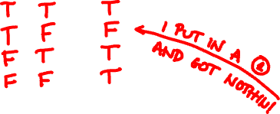
implies
P Q P → Q
1 + 1 = 2 → 1 + 1 = 3
1 + 1 = 3 → 1 + 1 = 2
1 + 1 = 3 → 1 + 1 = 4

Slide 21
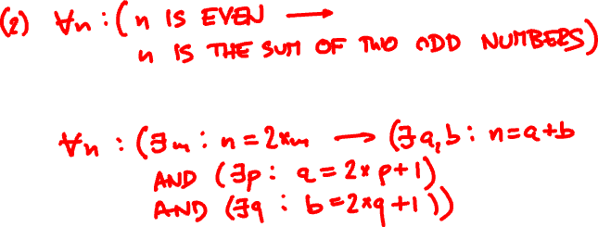

from English to propositional logic
(1)
Every even number is the sum of
two odd numbers.

Slide 22
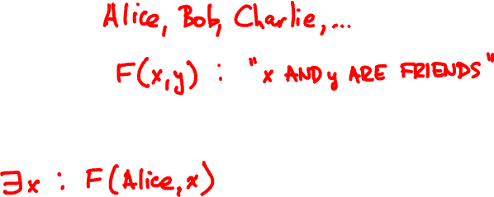
from English to propositional logic
universe:
relation(s):
1. Alice has friend(s).

Slide 23
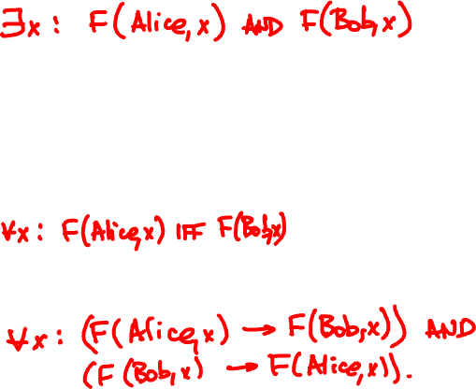

2. Alice is a friend of a friend of Bob.
3. Alice and Bob have the same friends.

Slide 24
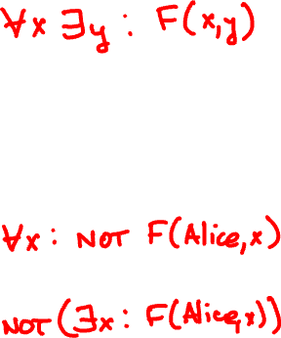
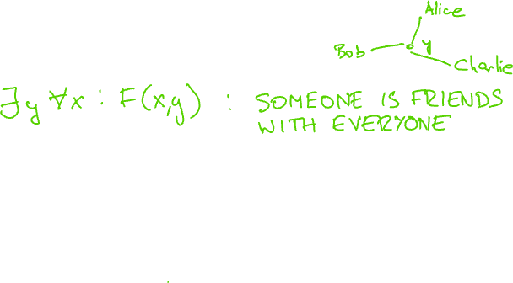
4. Everyone has a friend.
5. Alice has no friends.

Slide 25
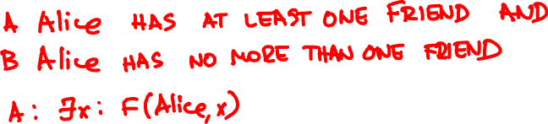
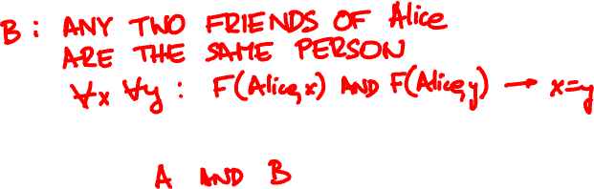
6. Alice has exactly one friend.

Slide 26

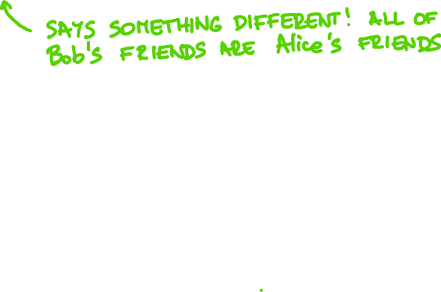
7. Alice has more friends than Bob.

Slide 27
from propositional logic to English
universe: classes (CSI 2101, …)
days (Mo, Tu, We, Th, Fr, Sa, Su)
M(c, d):
class c meets on day d
1. ∀c ∃d: M(c, d)

Slide 28


2. ∃d ∀c: NOT M(c, d)
3. NOT ∀d ∃c: M(c, d)

Slide 29
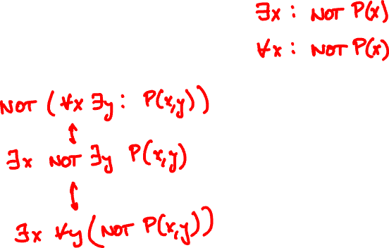

quantifier logic: negation
NOT ∀x: P(x)
NOT ∃x: P(x)

Slide 30

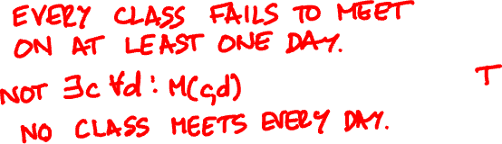
4. ∃d ∀c: M(c, d)
5. ∀c ∃d: NOT M(c, d)

Slide 31
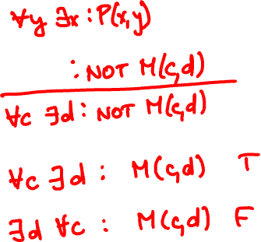

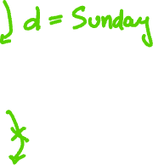
quantifier logic: universal instantiation
∃x ∀y: P(x, y)

Slide 32

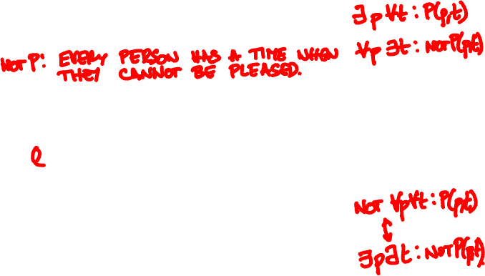

quantifier logic: negation
You can please
some of the people all of the time,
and you can please
all the people some of the time,
but you cannot please
all the people all the time

Slide 33
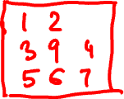
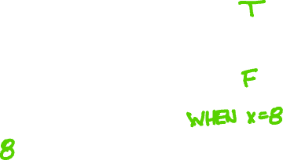
A 3x3 table is filled with different numbers.
Are these predicates equivalent?
(1) x is the largest number in its column
and x is the largest number in its row.
(2) x is the largest number in the table.

Slide 34
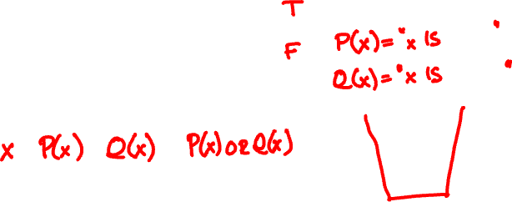



quantifier logic
Does (1) imply (2)?
(1) ∀x: (P(x) OR Q(x))
(2) (∀x: P(x)) OR (∀x: Q(x))

